Slide 1
How to work with this learning material
Power Point
The following power point presents the topic INTERNATIONAL WATERWAYS. The slides are shortly described in the notes below, they also provide the link to the source if you need further information.
Reader
In addition to the power point presentation, you can also use the reader provided on our platform. It’s more detailed and can be used as a script for your lessons.
Links
You can find the sources of our presentation and reader in the link section of the relevant bundled teaching material.
Videos and exercises
There are different videos and exercises used as sources in this presentation. You can find these videos and also a variety of exercises separately in the corresponding section of the relevant bundled teaching material.
https://www.rewway.at/en/teaching-materials/bundles/international-waterways/

Slide 2
Learning objectives and target groups
After having studied the contents, the learners know…
the characteristics of large waterways, including the classification of large waterways, maintenance measures, information on bridges, locks and the fairway and the influence of different weather conditions.
the inland waterways in Europe. A market overview, as well as details of the main waterways in Europe and a comparison between the Rhine and the Danube. Also information on the Mannheim Act and on TEN and TEN-T.
the waterways in Asia with focus on China. The most important markets, the largest river Yangtze, and information about the Three Gorges Dam.
waterways in South America with focus on Brazil and the Amazon River.
In the last chapter the Europe, Asia and South America are compared and a conclusion is drawn.
Target groups
University students
Vocational school students

Slide 3
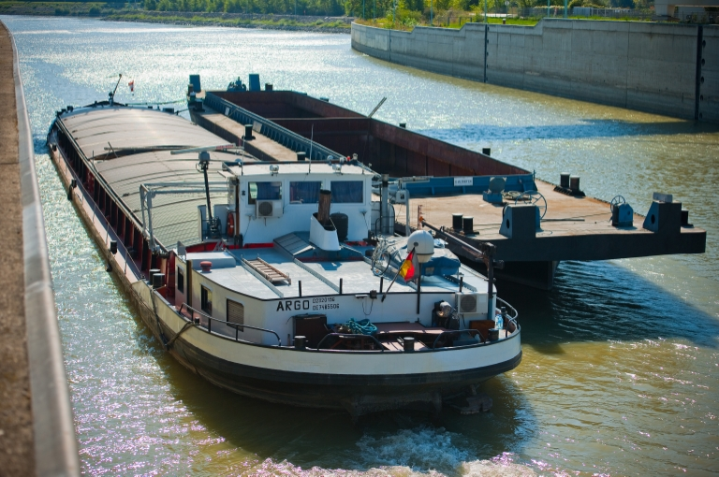
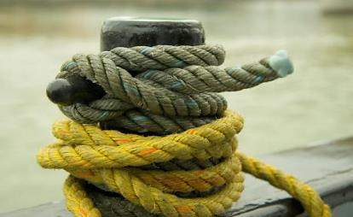
International Waterways
Source: viadonau
Source: viadonau
Notes:
Pictures: viadonau on https://fotos.viadonau.org; viadonau in Manual on Danube Navigation p. 106

Slide 4
Warm-Up-Discussion International Waterways
Which waterways in Europe do you know?
Which country in the world has the most available navigable waterways?
Source: pixabay
Notes:
The questions mentioned in the slide above can be used as a warm up exercise for the topic “International Waterways”. The aim is to discuss the questions in plenum with students. Answers to the questions will be provided during the presentation. Therefore, the questions can be discussed again at the end of the presentation.
Discussion question (5-10 Minute Discussion):
Which country in the world has the most available navigable waterways? China
Which waterways in Europe do you know?
Rhine, Danube, Wolga, Rhine-Main-Danube-Corridor etc.
Input- possible topics of discussion:
Waterway requirements
Infrastructure
Ports
Picture: www.pixabay.com

Slide 5
Agenda
Comparison
Inland Waterways in China
Inland Waterways in Europe
Competitive Factors of Inland Navigation
Inland Waterways in Brazil
Notes:
In this section of the presentation the competitive factors of inland navigation are discussed. These include, amongst other, the waterway infrastructure and weather conditions.

Slide 6
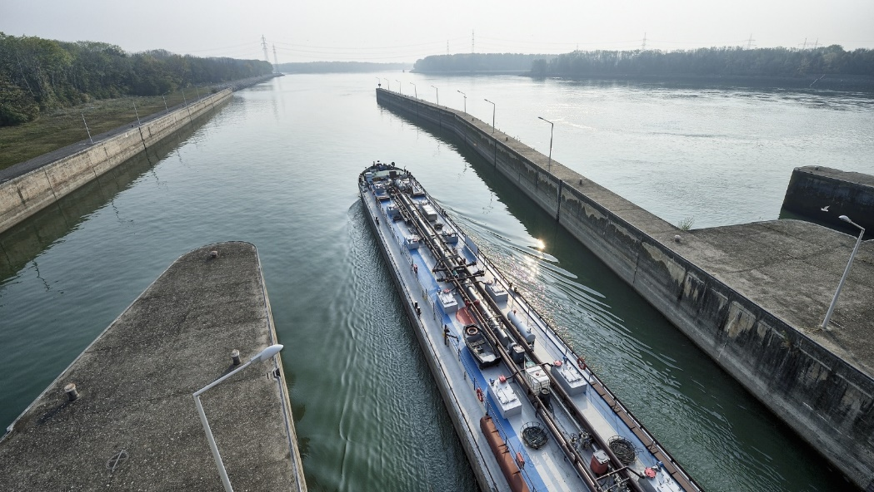
Competitive Factors of Inland Navigation
Waterway Infrastructure
= key factor for the competitiveness of inland navigation
Quality and reliability of waterway infrastructure
Fairway
depending on infrastructure - bridges, locks,…
weather conditions
availability
Ports as multimodal hubs
Geographic location (topography and political/economic importance)
Source: viadonau
sources: diverse
Notes:
The infrastructure of inland waterways is a key factor for the competitiveness of inland navigation. Therefore, it is crucial to guarantee the quality and reliability of waterways to enhance an increased use of inland waterways as a transport mode. In this context, the fairway can be identified as one of the most important infrastructure elements to enable economical efficient transport on inland waterways. Since transport can‘t be performed only by an inland vessel in most cases, transhipments to other transport modes such as trucks are necessary. Consequently, multimodal hubs with appropriate infrastructure are needed to enhance the use of different transport modes within the transport chain. Thus, ports are an important infrastructure element to connect inland waterways to other transport modes. In addition, regular maintenance is needed to guarantee quality and reliability of waterway infrastructure and continuous improvement of the infrastructure.
The waterway infrastructure is also influenced by external factors such as weather conditions and the location of the respective inland waterway. Weather conditions can be very different within Europe and on a global perspective. Therefore, transport conditions on inland waterways can vary in different countries and continents.
In addition, the topography of a country and the political and economic importance of inland navigation in the respective country have an influence on the competitiveness of inland navigation. Even though a country may have a wide network of navigable inland waterways, political promotion for inland navigation is required in most countries to guarantee an increased use of inland waterway transport as an alternative to transport by truck.
Sources:
viadonau, “Good Practice Manual on Inland Waterway Maintenance. Focus: Fairway maintenance of free-flowing rivers”, (2016) p.6, Online: http://www.savacommission.org/dms/docs/dokumenti/documents_publications/platina/platina_2_manual_on_waterway_maintenance_final.pdf [26.04.2020]
Juha Schweighofer, “The impact of extreme weather and climate change on inland waterway transport” in Natural Hazards, May 2014, Volume 72, Issue 1, p 23-40, p. 25.
Picture: viadonau in https://fotos.viadonau.org

Slide 7
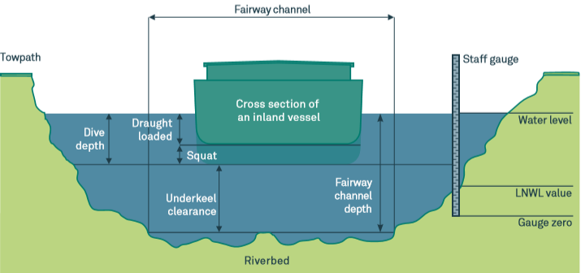
Fairway Depth Competitive Factors of Inland Navigation
Critical for transport on waterway
Possible freight volume depends on fairway depth
Width and course of fairway are marked by internationally standardised fairway signs
Influencing cost-effectiveness of inland waterway transport
Source: viadonau
Notes:
The fairway or fairway channel is the area of a body of inland water for which certain fairway depths and fairway widths are maintained for navigation purposes. The width and the course of the fairway are marked by internationally standardised fairway signs such as buoys or marks on river banks.
The fairway depth is critical for the transport on a waterway because the possible freight volume of a vessel depends on the fairway depth. Water depths available in the fairway determine how many tons of goods may be carried on an inland cargo vessel. The more cargo loaded on board of a vessel, the higher is its draught loaded, i.e. the draught of a ship when stationary and when carrying a certain load. The draughts loaded which may be realised by navigation companies have a decisive influence on the cost-effectiveness of inland waterway transport.
Sources: Manual on Danube navigation, p. 49-51
Picture: viadonau in Manual on Danube Navigation, P. 50

Slide 8
Fairway Depth Competitive Factors of Inland Navigation
Different factors influence Fairway Depth
under keel clearance = safety clearance to riverbed
squat → ships sink when they are in motion, depends on cross sections
cross section of fairway (depth and width) base on minimal cross section
maintenance
Source: viadonau
Notes:
For rivers, the determination of the cross section of the fairway, i.e. its depth and width, is based on a “minimal” cross section. This minimal cross section is inferred from the “most shallow” and “most narrow” stretches of a certain river section at low water levels.
In calculating the potential draught loaded of a vessel on the basis of current fairway depths, the dynamic squat as well as an appropriate safety clearance to the riverbed, the so-called underkeel clearance, have to be considered in order to prevent groundings of cargo vessels in motion. The total depth of a ship equals the sum of its draught loaded and its squat.
The safety clearance is termed underkeel clearance and is defined as the distance between the bottom of a vessel in motion and the highest point of the riverbed. Underkeel clearance should not be less than 20 centimetres for a riverbed made of gravel or 30 centimetres for a rocky bed in order to prevent damage to the ship’s propeller and/or its bottom.
Squat refers to the level to which a ship sinks while it is in motion compared to its stationary condition on waterways with a limited cross section (i.e. rivers and canals). A loaded vessel has a squat within a range of about 20 to 40 centimetres, depending on the different cross sections of a river and the velocity of a vessel.
The authorities and organisations responsible for maintaining a waterway aim to keep fairways at a constant minimum depth, e.g. by conservational dredging measures in the fairway. These so-called minimum fairway depths of a fairway are geared to low navigable water level (LNWL) as a statistical reference value for the water level.
Sources: Manual on Danube navigation, S.49-52
Picture: viadonau in Manual on Danube Navigation, P. 50

Slide 9
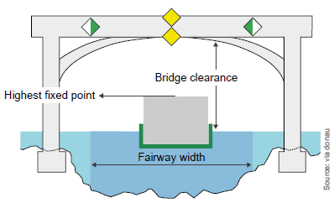
Bridges Competitive Factors of Inland Navigation
Can span a waterway or a lock facility (port entrance, river power plant)
Passage depends on
bridge clearance
highest fixed point of vessel (HNWL*)
water level → fairway width (LNWL*)
distance between bridge pillars
*HNWL = Highest navigable water level
*LNWL = Lowest navigable water level
sources: via donau
Notes:
Bridges can span a waterway, a port entrance or a river power plant and hence a lock facility. On free-flowing, i.e. unimpounded river sections, water levels can be subject to considerable fluctuations which influences the potential passage under bridges at high water levels.
Depending on the distances between the individual bridge pillars there will be one or more – in most cases two – openings for passage of vessels. If a bridge has two openings for passage which are dedicated for navigation purposes, one is generally used for upstream traffic and the other for downstream traffic. Whether a vessel can pass under a bridge depends on the bridge clearance above the water level and on the highest fixed point of the vessel.
The air draught of a vessel is the vertical distance between the waterline and the highest fixed point of a vessel once movable parts such as masts, radar devices or the steering house have been removed or lowered. The air draught of a vessel can be reduced by ballasting the vessel. For this purpose, ballast water is pumped into the ballast tanks or solid ballast is loaded.
In addition to the height of bridge openings and a vessel’s air draught, the bridge profile is another factor which determines whether a vessel is able to pass under a bridge. For sloped or arch-shaped bridges, not only a vertical but also a sufficiently dimensioned horizontal safety clearance must be ensured. As the figures indicating the height and width of an opening for passage below a bridge always refer to the entire width of the fairway, the clearance below the crest of arch-shaped bridges, i.e. below the centre of the bridge, is higher than at the limits of the fairway.
On free-flowing sections of rivers, vertical bridge clearance is indicated in relation to the highest navigable water level (HNWL), whereby the indicated passage height corresponds to the distance in metres between the lowest point of the lower edge of the bridge over the entire fairway width and the highest navigable water level. The width of the fairway below a bridge is indicated in relation to lowest navigable water level (LNWL). In river sections regulated by dams, the maximum impounded water level serves as the reference value both for the vertical and the horizontal bridge clearance. The reference level on artificial canals is the upper operational water level.
Sources: Manual on Danube navigation, p. 55-56
Picture: viadonau in Manual on Danube Navigation, p.56

Slide 10
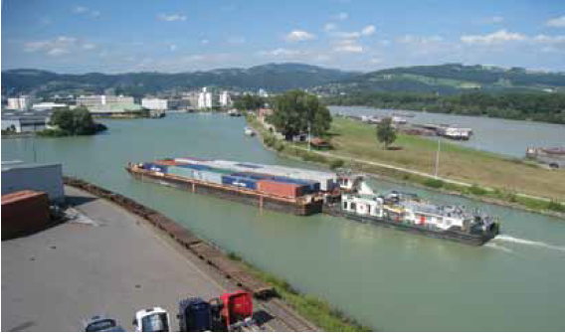
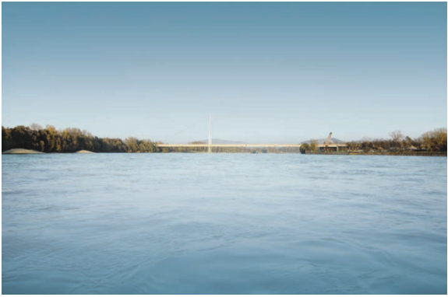
Bridges Competitive Factors of Inland Navigation
129 bridges along the whole Danube
42 bridges on the Austrian Danube
maximum 2-3 layered container transport possible on the Danube → actually nearly no container transport on the Upper Danube (hardly profitable)
container transport mainly on the Rhine
→ Influence on cost-effectiveness of inland waterway transport
source: viadonau
Source: viadonau
Source: viadonau
Notes:
Between Kelheim and Sulina, a total of 129 bridges span the international Danube waterway. Of these 129 Danube bridges, 21 are bridges over locks and weirs. By far the highest density of bridges, namely 89, can be found on the Upper Danube: 41 bridges span the German section of the Danube, 42 the Austrian and six the Slovakian sections of the Danube. On the Central Danube there are a total of 34 bridges; on the Lower Danube there are only seven. Therefore, maximum 2-3 layered container transport is possible on the Danube and there is actually nearly no container transport on the Upper Danube. This is because transport would not be profitable. In comparison, a lot of container transports are performed on the Rhine, due to other prerequisites in terms of infrastructure.
Bridges mainly influence the cost-effectiveness of inland waterway transport because they influence the transport volume of inland vessels.
Sources: Manual on Danube navigation, p. 55-56.
Pictures: viadonau im Manual on Danube navigation, p. 117
viadonau/Pilo Pichler im Manual on Danube navigation, S.39

Slide 11
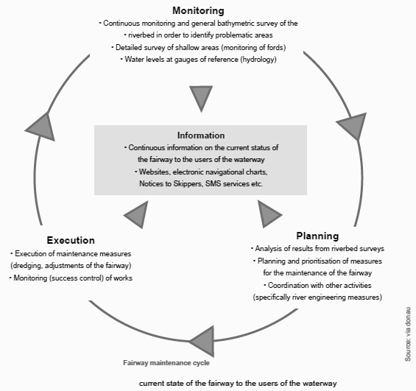
Maintenance Competitive Factors of Inland Navigation
Important for competitive waterway infrastructure
Waterways as living systems are influenced by constant changes
Riverbed surveying to guarantee minimum fairway parameters
Dredging works required
Establishing a „fairway maintenance cycle“
sources: via donau, Inland Navigation Europe, Danube Commission
Notes:
In the case that the minimum fairway parameters are not achieved, inland waterways cannot be used economical. Therefore, continuous maintenance is crucial to guarantee the competitiveness of inland waterways.
The responsible waterway administration is obliged to take suitable measures in order to re-establish the minimum fairway parameters.
This is generally accomplished by dredging shallow areas (fords) within the fairway. Dredging is an excavation operation with the purpose of removing bottom sediments (sand and gravel) and disposing of them at a different location in the river in due consideration of ecological aspects. Dredging works require initial planning on the basis of the results gained from regular riverbed surveying and a concluding monitoring (control of success) of the works, which have to be carried out by the responsible waterway administration. As these tasks of maintaining the fairway are recurrent and interdependent, they can be described as a “fairway maintenance cycle”. Among the most important tasks of this cycle are:
• Regular bathymetric surveys of the riverbed in order to identify problematic areas in the fairway (reduced depth and widths)
• Planning and prioritization of necessary interventions (dredging measures, realignment of the fairway, traffic management) based on the analysis of up-to-date riverbed surveys
• Execution of maintenance works (mainly dredging measures, including success control)
• Provision of continuous and target group-specific information on the current status of the fairway
Sources: Manual on Danube navigation, p. 58-59
Picture: viadonau in Manual on Danube Navigation p. 59

Slide 12
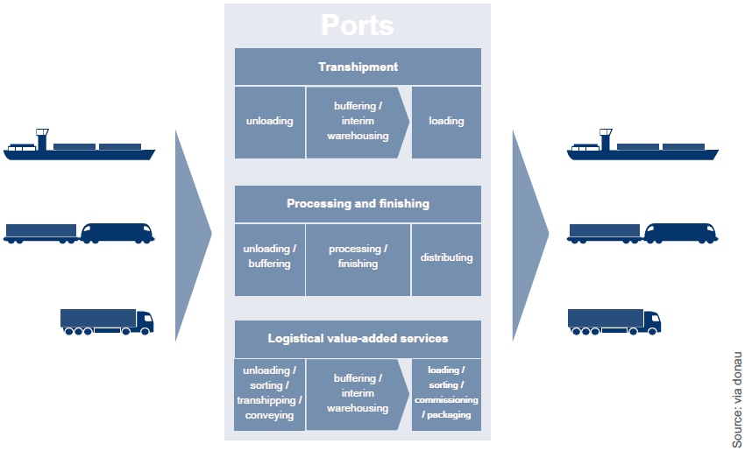
Ports Competitive Factors of Inland Navigation
Traffic hubs between transport modes
multimodal logistic hubs
Tasks:
transhipment
unloading, warehousing and loading
storage
different types of storage depending on type of cargo (open, covered and special warehouses)
value-added logistics service
packing, container stuffing and stripping, sanitation, quality checks
Development trends
specialization of ports to specific transport sectors and types of cargo → competitive advantages
green ports – increasing importance of sustainability
sources: via donau
Notes:
Ports are an important infrastructure element because they are the connection between the transport modes road, rail and waterway and are important service providers in the fields of transhipment, storage and logistics. In addition to their basic functions of transhipment and storage of goods, they also often perform a variety of value-added logistics services to customers, such as packaging, container stuffing and stripping, sanitation and quality checks. This enhances ports as logistics platforms and impetus sources for locating companies and boosting the economy. As multimodal logistics hubs, they act as a central interface between the various modes of transport. The total throughput for all modes of transport is an important indicator of the performance of a port. A port not only handles transhipments between waterway, road and rail, but also between non-waterbound modes such as road-rail or rail-rail.
Development trends
The range of services offered by a port needs to be attractive to shippers and logistics service providers. In addition to multi-purpose ports, specialized ports also exist which focus their business on a particular type of cargo. The specialisation of a port to specific transport sectors can lead to competitive advantages. The port may specialise in a specific type of cargo on the basis of greater demand for such goods and/or increased cargo volumes in the hinterland of the port. For this reason multiple specialised terminals may be found in a port. A form of specialisation is, for example, the field of high & heavy cargo. Heavy cargo ports, which are specialised in over-sized cargo, require special technical equipment together with specialised logistics solutions. Approved lifting technology and equipment with high load capacity are the prerequisite of a heavy cargo port. Special transhipment equipment is also needed, for example, for the handling of liquid bulk goods such as liquefied natural gas (LNG) or crude oil. Special suction and pumping equipment is required in the port for such operations. Due to the fact that the majority of transhipped liquid cargoes are dangerous goods, special safety precautions have to be observed in the port.
Green Ports, i. e. sustainable port management, is a trend which has become increasingly more predominant in the field of port development over the last few years. Green Ports aim to strike a balance between environmental impact and economic interests. The core of the “Europe 2020” strategy of the European Commission is sustainable growth (European Commission 2010a). Furthermore, national and regional political strategies are intended to lead to more sustainability in the field of port development. Together with the development of ports, the concept Green Ports also includes the total redesign of logistics chains.
Sources: Manual on Danube navigation, p. 86-88, 101-103
Picture: viadonau in Manual on Danube Navigation p. 87

Slide 13
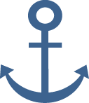
Weather Competitive Factors of Inland Navigation
High Water
Low Water
Caused by high precipitation, snow melt (winter floods)
Consequences:
suspension of navigation
delays
damage of infrastructure (e.g. vessels, ports, locks)
modification of inland waterways and bank morphology
flooding of areas
Main impact on waterway infrastructure
May last for a few days
Caused by low precipitation, high temperatures
Consequences:
cargo-carrying capacity
duration of transport
fuel consumption of vessel
May account for a longer period
High influence on inland waterway transport!
sources: Juha Schweighofer
Notes:
The occurrence of high water can be caused by high precipitation during a long time, snow melt after winter. A high water level has a main effect on the water level of the waterway and therefore effects transportation on inland waterways and the infrastructure of inland waterways. A high water level can lead to a suspension of navigation, delays, damage of infrastructure such as vessels, ports and locks due to drift wood. In addition the flooding of surrounding areas of inland waterways, the modification of the inland waterways itself and the bank morphology can be named as possible consequences. Thus, high water highly influences inland waterway transport by its negative impact on waterway infrastructure, which is crucial to guarantee an efficient transport by inland vessel. Usually high water only accounts for a few days in a year and therefore doesn‘t have a major influence on inland waterway transport.
Drought can be caused by periods of low precipitation and by high temperatures. Consequently, inland waterways are confronted with low water levels during drought periods. The affects on inland waterway transport are different to those of high water. On the one hand, the cargo-carrying capacity of inland vessels decreases due to shallow-water. On the other hand, the duration of transport may be longer which also leads to a higher fuel consumption of inland vessels.
Depending on the geographic location, droughts or floods can account for a longer period and therefore may also have a major impact on the economical efficiency of inland navigation. Thus high and low water can be identified as weather phenomena with a high influence on inland waterway transport.
Sources:
Juha Schweighofer, “The impact of extreme weather and climate change on inland waterway transport” in Natural Hazards, May 2014, Volume 72, Issue 1, p 23-40, p. 25-27.

Slide 14
Weather Competitive Factors of Inland Navigation
Ice
Wind
Visibility
thick ice
mainly waterways with low flow velocities and canalized sections are affected
Consequences:
infrastructure can be damaged
locks cannot operate
vessels cannot proceed (suspension for weeks possible)
mainly locally
effect depending on vessel type and transported cargo
Consequences:
interruption of transport
reduced manoeuvrability
collisions with waterway infrastructure
caused by fog, rainfall, haze, snowfall or other
Navigation by radar necessary
Consequences:
delays caused by interruption of transport and speed reduction
collisions with waterway infrastructure
Low influence on inland waterway transport!
sources: Juha Schweighofer
Notes:
In cold winters ice can have a major influence on inland waterway transport. If the layer of ice is very thick, inland vessels may not be able to proceed. Nevertheless, transport on inland waterways is only affected by ice on some waterways. For instance, on Rhine there hasn‘t been a suspension due to ice in the last 40 years. In fact, mainly waterways with low flow velocities and canalized sections with locks are affected by the occurrence of ice. Locks or other waterway infrastructure can be damaged which has an influence on the safety of navigation. Due to damaged locks, vessels may not be able to proceed and delays or suspensions occur.
Since most inland vessels are designed in a stable way, even strong winds don‘t have a major impact on inland navigation. Nevertheless, local high wind speeds can affect inland navigation. The effect depends on different factors such as vessel type and transported cargo. For example pushed convoys without cargo or container vessels with open cargo holds can be highly influenced by wind. As a result, the manoeuvrability of the inland vessel can be reduced which may lead to collisions with waterway infrastructure or other vessels. In addition, more time may be needed for manoeuvring operations which causes delays. The transport can also be interrupted if a safe continuation is endangered.
If the visibility is reduced due to fog, rainfall, haze, snowfall or other reasons, inland vessels have to navigate by radar. Depending on the actual situation, the master of a vessel has to undertake certain actions to guarantee security. Due to reduced visibility inland vessels have to proceed at a safe speed to avoid collisions with other inland vessels or waterway infrastructure. As a result, delays can be caused by an interruption of the transport or by speed reduction. In addition, accidents such as a collision with waterway infrastructure may occur.
Source:
Juha Schweighofer, “The impact of extreme weather and climate change on inland waterway transport” in Natural Hazards, May 2014, Volume 72, Issue 1, p 23-40, p. 27-29.

Slide 15
Geographic Location and Political Importance Competitive Factors of Inland Navigation
Navigable waterways:
Asia (China, Russia, Vietnam), North-America (USA) and South-America (Brazil) have most available waterways
France, Finland and Germany (Europe) have most available waterways
Greece, Liechtenstein and Luxembourg (Europe) have least available waterways
Political importance
aim of European Commission: promote and strengthen inland waterways as eco-friendly transport system
China: high economical contribution
Brazil: waterway management is inefficient
Transport policies of countries
Europe: 26 billion € infrastructure budget
China: highest amount spent on infrastructure ( 8.5 % of GDP)
sources: diverse
Notes:
Due to different geographical prerequisites, countries may have a lot or little available waterways. At a global level, China and Russia have the most available navigable waterways. In Europe, France, Finland and Germany have the most available waterways. In comparison, Greece, Liechtenstein and Luxembourg have the least available waterways in Europe which are navigable.
Therefore, the prerequisites for inland navigation differ at continental and country level due to available navigable waterways.
Another factor that influences the use of inland waterways as a transport mode is their political importance. In Europe, inland waterways are important for freight transport. The European Commission aims to strengthen inland navigation through a variety of measures such as promotion programs and cost benefits. In China, water transport can also be seen as a very important part of freight transport. Inland waterways have been the most important transport mode for many years and therefore are also of economical importance. In contrast, in Brazil, inland waterways are not an important transport mode. Moreover, waterway management of inland waterways is inefficient.
The political importance of inland waterways also has an influence on transport policies and therefore also investments in transport. Infrastructure measures are expensive and therefore need to be supported by politics. China is the world‘s largest investor in infrastructure. In the period 1992-2011 China spent 8.5 % of its gross domestic product (GDP) on infrastructure investments. The greater part of this sum has been spent on investments in road, power, rail and water infrastructure. In comparison, Europe spent 2.6 % of the GDP on infrastructure investments. To realise transport projects, the EU transport infrastructure budget for the period 2014 – 2020 was set at 26 billion euro. In contrast, in Brazil investments in waterways have a low priority. In general, Latin America only spent 1.8 % of its GDP on infrastructure investments.
Sources:
Indexmundi, URL: http://www.indexmundi.com/map/?t=10&v=116&r=xx&l=en [24.04.2020]
Chen Y., Matzinger S., Woetzel J., “Chinese infrastructure: The big picture”, URL: http://www.mckinsey.com/global-themes/winning-in-emerging-markets/chinese-infrastructure-the-big-picture [24.04.2020]
DeWoskin K., “China”, URL: http://www.britannica.com/place/China/Waterways [24.04.2020]
Inland navigation Europe, “EU waterway infrastructure priorities for 2014-2020”, URL: http://www.inlandnavigation.eu/news/infrastructure/eu-waterway-infrastructure-priorities-for-2014-2020/ [24.04.2020]
European Commission, “Inland Waterways”, URL: http://ec.europa.eu/transport/modes/inland/index_en.htm [24.04.2020]
World Wide Inland Navigation Network, URL: http://www.wwinn.org/china-inland-waterways [24.04.2020]

Slide 16
Quiz Competitive Factors of Inland Navigation
How many bridges are along the Danube?
260 c) 190
215 d) 129
Notes:
How many bridges are along the Danube?
129, 42 in Austria

Slide 17
Agenda
Comparison
Inland Waterways in China
Inland Waterways in Europe
Competitive Factors of Inland Navigation
Inland Waterways in Brazil
Notes:
In this section of the presentation the main characteristics of inland navigation in Europe are presented. In addition, the most important inland waterways, the biggest inland and maritime ports in Europe are discussed.

Slide 18
Market overview Inland Waterways in Europe
544 million tons of cargo transported in total on European inland waterways (2018)
Netherlands: inland navigation with around 41.6 % (2020) largest modal split share
Rhine-Main-Danube-Corridor most important inland waterway axis on the European mainland
sources: diverse
Notes:
In 2018, 544 million tons of goods were transported on inland waterways in Europe (total transport performed: 135 billion tonne-kilometres). As shown in the pie chart, 6% of all freight transports were carried out by inland vessel in 2018 in Europe. The Netherlands have the largest share of inland waterway transport in Europe.
The most important waterway axis on the European mainland is the Rhine-Main-Danube-Corridor. The Rhine and Danube river basins, which are connected by the Main-Danube Canal, are the backbone of this axis. This waterway axis connects 15 countries in Europe via inland waterways. More information about the Rhine-Main-Danube-Corridor is provided on slides 19-21.
Sources: Manual on Danube navigation, p.44
Eurostat, “Freight transport statistics – modal split”, (2018), URL: http://ec.europa.eu/eurostat/statistics-explained/index.php/Freight_transport_statistics_-_modal_split [24.04.2020]
Eurostat, “Inland waterway transport statistics”, URL: http://ec.europa.eu/eurostat/statistics-explained/index.php/Inland_waterway_transport_statistics [24.04.2020]

Slide 19
European Waterways Inland Waterways in Europe
E Waterway network
1996: European Agreement on Main Inland Waterways of International Importance (AGN)
Consistent of European inland waterways and coastal routes and ports
Important for international freight transport
Designation: letter „E“ followed by a number/combination of numbers (main inland waterways: two-digit numbers; branches: four- or six-digit number for branches of branches)
Example: Danube= E80 and its navigable tributary the river Sava (Croatia) = E 80-12
sources: via donau
Notes:
In order to create the most uniform conditions possible for the development, maintenance and commercial use of Europe’s inland waterways, in 1996 the Inland Transport Committee of the United Nations Economic Commission for Europe (UNECE) adopted the European Agreement on Main Inland Waterways of International Importance (AGN) (United Nations Economic Commission for Europe 2010). The Agreement, which came into force in 1999, constitutes an international legal framework for the planning of the development and maintenance of the European inland waterway network and for ports of international importance, and is based on technical and operational parameters.
By ratifying the Agreement, the contracting parties express their intention to implement the coordinated plan for the development and construction of the so-called E waterway network. The E waterway network consists of European inland waterways and coastal routes which are of importance for international freight transport, including the ports situated on these waterways. E waterways are designated by the letter “E” followed by a number or a combination of numbers, whereby main inland waterways are identified by two-digit numbers and branches by four- or six-digit numbers (for branches of branches). The international waterway of the Danube is designated as E 80 and its navigable tributary the Sava, for example, as E 80-12.
Sources: Manual on Danube navigation, p. 42-43

Slide 20
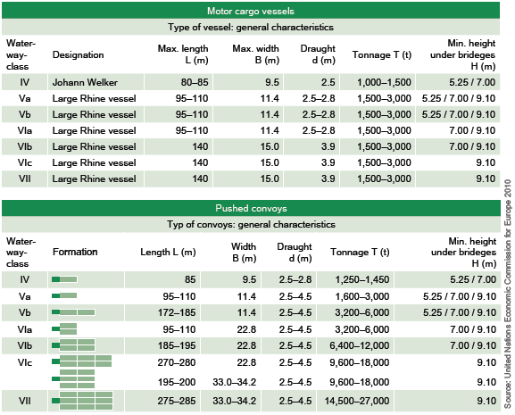
Classification of European Waterways Inland Waterways in Europe
European waterways are identified by Roman numbers (I – VII)
Waterways of class IV or higher → important for international freight transport
Classes below have regional/national importance
Class is determined by maximum dimensions of the vessels on waterway → factors: width and length of inland vessels and convoys
sources: via donau
Notes:
The table above shows the parameters of international waterway classes based on the type of vessels and convoys which can navigate the waterway of the respective class.
Waterway classes are identified by Roman numbers from I to VII. Waterways of class IV or higher are of economic importance to international freight transport. Classes I to III identify waterways of regional or national importance. The class of an inland waterway is determined by the maximum dimensions of the vessels which are able to operate on this waterway. Decisive factors in this respect are the width and length of inland vessels and convoys, as they constitute fixed reference parameters. Restrictions regarding the minimum draught loaded of vessels, which is set at 2.50 meters for an international waterway, as well as the minimum height under bridges (5.25 meters in relation to the highest navigable water level) can be made only as an exception for existing waterways.
Sources: Manual on Danube navigation, p. 42-43
Pictures: United Nations Economic Commission for Europe, 2010 in Manual on Danube Navigation, p. 43

Slide 21
Inland Navigation in Europe Inland Waterways in Europe
Available inland waterways:
40,000 km → 20,000 km navigable for ≥ 1,000 ton vessels
19 out of 28 EU Member States have access to navigable waterways
Top 3 in Europe:
h
Available waterways | Freight transport on inland waterways (% of total tkm)
France (8,501 km*) Finland (8,000 km*) Germany (7,467 km*) → Austria (358 km *) | Netherlands: 43.2 % Romania: 27.1 % Bulgaria: 25.5 % → Austria: 2.1 %
* Total length of navigable rivers, canals and other bodies of water
sources: diverse
20
Notes:
There are 40,000 km of waterways in Europe of which the half is navigable for ≥ 1,000 ton vessels. In 2018, 19 out of 28 EU Member States had access to navigable waterways. Within Europe, France has the most available waterways (including rivers, canals and other bodies of water which are navigable), followed by Finland. Germany is ranked on the third place. By contrast, Austria has 358 km of navigable waterways and is ranked on the 26th place.
Even though there are a lot of inland waterways available, inland navigation in general represents the less frequently used transport mode in Europe. Nevertheless, there are different values at national levels: In the Netherlands inland navigation has the highest share of the modal split of inland freight transport with 43.2% in 2018 (% of total tonne-kilometres) and also Romania and Bulgaria have a relative high share in comparison to other countries in Europe. In contrast, inland navigation has a very low or even perhaps no share at all of the modal split in other countries (e.g. Austria, Latvia or Lithuania). This differences can be explained by different limiting factors for inland navigation such as accessibility, transport distance and transport volume. The accessibility to inland waterways by ports is crucial to enhance the increased use of inland waterways. In addition inland navigation is more likely to be used if the transport distance is relative long and the transport volume is relative high. This is only possible if appropriate waterway infrastructure is available.
Sources: Manual on Danube Navigation, p.44
“Facts & Figures- Inland Navigation in Europe”, slide 2, URL: http://de.slideshare.net/carolinevandeleur/platina-ff-general-14427068 [24.04.2020]
Eurostat, “Freight transport statistics – modal split”, (2016), URL: http://ec.europa.eu/eurostat/statistics-explained/index.php/Freight_transport_statistics_-_modal_split [24.04.2020]
Eurostat: “Modal Split of Freight Transport”: URL: https://ec.europa.eu/eurostat/tgm/refreshTableAction.do?tab=table&plugin=1&pcode=t2020_rk320&language=en [24.04.2020]
Indexmundi, URL: http://www.indexmundi.com/map/?t=10&v=116&r=eu&l=en [24.04.2020].

Slide 22
Main traffic routes Inland Waterways in Europe
Route | Transported volume | Type of transport | Share of total transport performance*
Rhine route | > 200 million tons | Inter-national | 68 %
North-south route (France, Belgium & Netherlands) | 50 – 200 million tons | Inter-national | 16 %
East-west route in Germany | 10-50 million tons | national | 2 %
Main-Danube route | Less than 10 million tons | inter-regional and inter-national | 14 % (Danube)
*source: NEA (2007)
sources: diverse
Notes:
The largest volume transported on inland waterways is flowing from North Sea maritime ports such as Rotterdam, Antwerp or Amsterdam to Germany and Switzerland. Thus, about 68 % of the volume transported on inland waterways in Europe are transported on the Rhine route.
Also the North-South route from the Netherlands to Northern France via Belgium with a share of about 16 % is an important inland waterway transport route in Europe. This route is of importance for transports between France, Belgium and the Netherlands even though transport volumes are relatively small.
Another important inland waterway in Europe is the Danube with a share of 14 % of traffic.
In contrast, the East-West route represents only 2 % of the volume transported on inland waterways in Europe. Transport is mainly performed within Germany, between the Ruhr region and the area between Berlin and the Elbe.
With the exception of the East-West route, all mentioned inland waterway routes are important for international transport.
Sources:
Central Commission for the navigation of the Rhine, “Information on the waterway Rhine”, URL: http://www.ccr-zkr.org/12030100-en.html [24.04.2020]
Central Commission for the navigation of the Rhine, “Market observation for inland navigation in Europe”, (2008), p.11/12, Online:
http://www.ccr-zkr.org/files/documents/om/om07I_en.pdf [24.04.2020]
Pastori E., “Modal share of freight transport to and from EU ports”, (2015), p.29, Online:
http://www.europarl.europa.eu/RegData/etudes/STUD/2015/540350/IPOL_STU(2015)540350_EN.pdf [24.04.2020]
Quispel M., “Medium and long term perspectives of Inland Waterway Transport in the European Union”, Online: http://ec.europa.eu/transport/modes/inland/events/doc/2011-07-05-naiades-stakeholder/2011-07-05-presentation-perspectives.pdf [24.04.2020]

Slide 23
Rhine Route Inland Waterways in Europe
Length: 1,320 km – navigable: 885 km
Transported volume: 186 million tons (2018)
Average transport distance: 200 km
Important markets:
containers
weight-intensive goods
chemicals
2/3 of all goods transported on inland waterways in Europe pass through the Rhine
sources: diverse
Notes:
The route of the Rhine runs from Basel (Switzerland) to Rotterdam (Netherlands) and has a length of 884 km. In 2018, 330 million tons were transported on the Rhine, whereby the average transport distance was 200 kilometres. Two third of all goods transported on inland waterways in Europe pass through the Rhine. This points out the importance of this inland waterway for the European economy and transport sector.
The predominant transported goods in 2018 were solid mineral fuels, petroleum products and ores. These products are transhipped at different ports of which three are major maritime ports and fifteen are ports of major and important traffic. The highest amount of goods is transhipped at the port of Duisburg (inland port) and at the port of Rotterdam (maritime port).
The most important goods for transport on the Rhine are containers, weight-intensive goods and chemicals.
Sources: Manual on Danube navigation, p. 20-21
Observatory of European inland navigation, URL: http://www.inland-navigation.org/river/rhine/ [24.04.2020]
World wide inland navigation network, URL: http://www.wwinn.org/the-rhine [24.04.2020]
Picture: based on http://www.wwinn.org/the-rhine [24.04.2020]

Slide 24
Danube Route Inland Waterways in Europe
Length: 2,860 km (all navigable)
Transported volume: 39 million tons (2018)
Average transport distance: 600 km
Important markets:
iron and ores
sources: Observatory of European inland navigation, via donau
Notes:
The total length of the Danube is 2,860 kilometres, whereas the entire stretch would be navigable. The transported volume in 2018 was 39 million tons and cargo was transported on an average distance of 600 kilometres. The most important market for freight transport on the Danube is the transport of metal waste and ores. Thus, the product category of ores and metal wastes can be identified as the most frequently transported goods on the Danube in 2018, followed by petroleum and agricultural products.
Sources: Manual on Danube navigation, p. 20, 21
Annual report on Danube Navigation in Austria (2021), p. 20
Picture: based on Annual report on Danube Navigation in Austria, p. 20

Slide 25
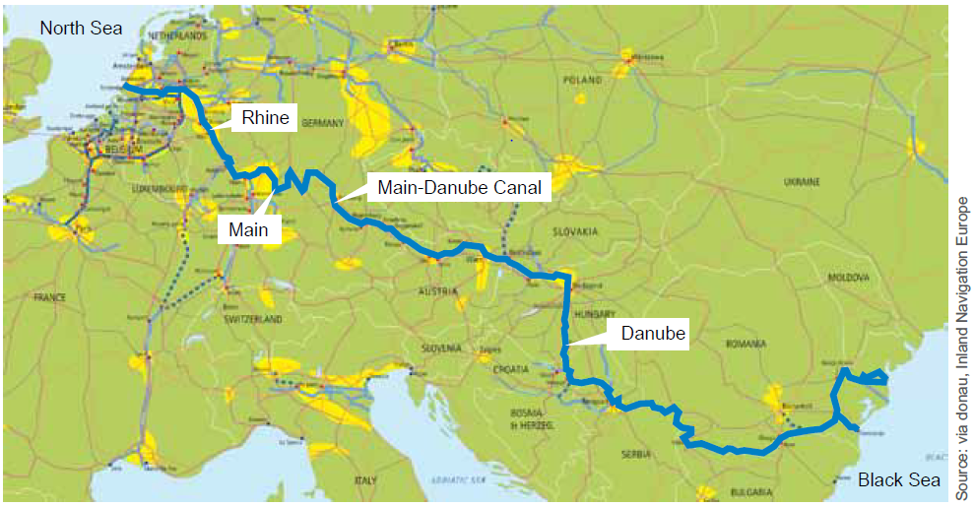
Rhine-Main-Danube Corridor Inland Waterways in Europe
Length: 3,500 kilometres
Route: Port of Rotterdam (NL) to Port of Constanta (RO)
Connecting 15 countries
Rhine vs. Danube:
Transported volume: 6.9 times more goods were transported on Rhine
Length: Danube is 2.7 times longer than Rhine
→ Different infrastructural preconditions
Limited ramification of Danube waterway
Bridges – 129 bridges span international Danube
Density of population and economic activity at Rhine
sources: diverse
Notes:
The Rhine-Mine-Danube Corridor has a total length of 3,500 kilometres and it connects the port of Rotterdam (Netherlands) with the port of Constanta (Romania), connecting 15 countries in Europe.
Even though the Danube is 2.7 times longer than the Rhine, almost seven times more goods were transported on the Rhine. This is due to different infrastructural preconditions of these two inland waterways: The limited ramification of the Danube waterway enables only a spatially concentrated use, confining the Danube to a limited form of transport requiring longer pre- and end-haulage by road or rail. For this reason, inland navigation in the Danube region usually has a lower share of national modal split figures. In addition, a total of 129 bridges span the international Danube waterway. This leads to restrictions concerning the possible transport volume of inland vessels.
Furthermore, the Rhine has four main tributaries which strengthen the role of the Rhine as the most important waterway in Europe. The economic activity and the high density of population along the Rhine also support an increased use of this inland waterway as a transport mode.
Sources: Manual on Danube Navigation, p. 20,21, 59
Picture: viadonau, Inland Navigation Europe in Manual on Danube Navigation, p. 44

Slide 26
Seine Inland Waterways in Europe
Annually > 20 Mio. tons of transported goods (2018)
Seine basin is the most important basin in France regarding the transportation of goods
2018: 4 billion tkm
Important markets:
Containers
Building materials
Agricultural products
Paris = second biggest European inland port
Sourcee: pixabay
source: central commission for the Rhine Navigation
Notes:
In terms of freight transport, the Seine basin is the most important river basin in France, with around 20 million tonnes of freight transported each year. Its main waterways are the Seine, Oise, Marne rivers and canals, such as the Canal du Nord, which is being upgraded by the Canal Seine Nord-Europe project. The main markets are sands, stones and building materials.
Source: Zentralkommission der Rheinschifffahrt, Marktbeobachtung 2019, URL: https://inland-navigation-market.org/wp-content/uploads/2019/11/ccnr_2019_Q2_de-min2.pdf.pdf [24.04.2020].
Picture: www.pixabay.com

Slide 27
Seine-North-Europe Canal (Project) Inland Waterways in Europe
start of construction 2017 - estimated construction time 7 years
106 km
Connects the Seine basin with the Rhine basin
Will replace:
The existing „Canal du Nord“
A part of the „Canal latéral à l‘Oise“
A small part of the river Oise
Existing waterways only allow a maximum capacity of 250-650 tons of inland vessels
New canal will allow up to 4.400 tons
sources: diverse
Notes:
The Seine-Nord Europe Canal, planned since the early 1960s, will replace the existing Canal du Nord, which is part of the Canal latéral à l'Oise and a short stretch of the river Oise. The works will inevitably have an impact on the conditions of navigation through the Canal du Nord and the Canal latéral à l'Oise. The new canal will provide a missing link of European importance by linking the Seine basin with the Rhine basin and the main European inland waterway network via the Nord-Pas de Calais region. It will extend over 106 km from Aubencheul-au-Bac on the Dunkerque-Escaut waterway to Compiègne on the Oise. The existing waterways on this route have a limited capacity (barges from 250 to 650 tonnes). The new canal will eliminate this capacity bottleneck and will form an important corridor with high capacity for barges and push boats up to 4400 tonnes from Le Havre to Dunkirk, the Benelux countries and the Rhine.
Source: French Waterways, URL: https://www.french-waterways.com/waterways/north/seine-nord-europe/ [25.05.2020]

Slide 28
Biggest ports in Europe Inland Waterways in Europe
Maritime ports | Weight of goods handled (in million tons)
Rotterdam (Netherlands) | 469.4 (2019)
Antwerp (Belgium) | 238.1 (2019)
Hamburg (Germany) | 136.6 (2019)
Marseille (France) | 81.1 (2018)
Inland ports | Weight of goods handled (in million tons)
Duisport (Germany) | 123.7 (2019)
Liège (Belgium) | 13.5 (2014)
Constanta (Romania) | 66.6 (2019)
Galati (Romania) | 4.4 (2017)
Notes:
In the tables above, four of the biggest maritime ports and 4 important inland ports in Europe according to the weight of goods handled are indicated. Whereas for the maritime ports all numbers are from 2018/2019, the numbers for the inland ports were collated from different sources and different years.
Sources:
DVZ (2019): URL: https://www.dvz.de/rubriken/see/haefen/detail/news/frankreichs-fuehrende-seehaefen-mit-2018-zufrieden.html [24.04.2020]
Hafen Hamburg, Statistiken: URL: https://www.hafen-hamburg.de/de/statistiken [24.04.2020].
Hafen Rotterdam, Statistiken: URL: https://www.portofrotterdam.com/de/unser-hafen/fakten-und-zahlen-zum-hafen [24.04.2020].
Port of Antwerp: Statistisches Jahrbuch 2019, URL: https://www.portofantwerp.com/sites/portofantwerp/files/Statistisch%20Jaarboek%202019_1.pdf [24.04.2020].
Duisburg Hafen AG, Hafeninformation: URL: https://www.duisport.de/hafeninformation/?lang=en [24.04.2020]
Port de Liege, URL: http://www.portdeliege.be/assets/1a412596-e779-42c7-bfe8-50a9f450fb1f/20150304-CP-Trafics-2014_FINAL.pdf [24.04.2020].
Port of Constantza, Statistiken: URL: https://www.portofconstantza.com/pn/page/np_statistici_port [24.04.2020].
Port of Galati, Statistiken: URL: http://www.romanian-ports.ro/html_nou/traficapdm.php# [24.04.2020]

Slide 29
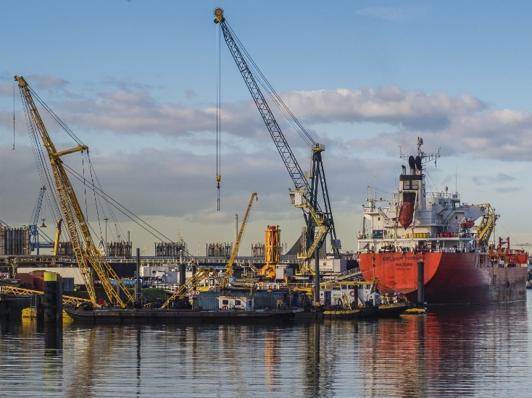
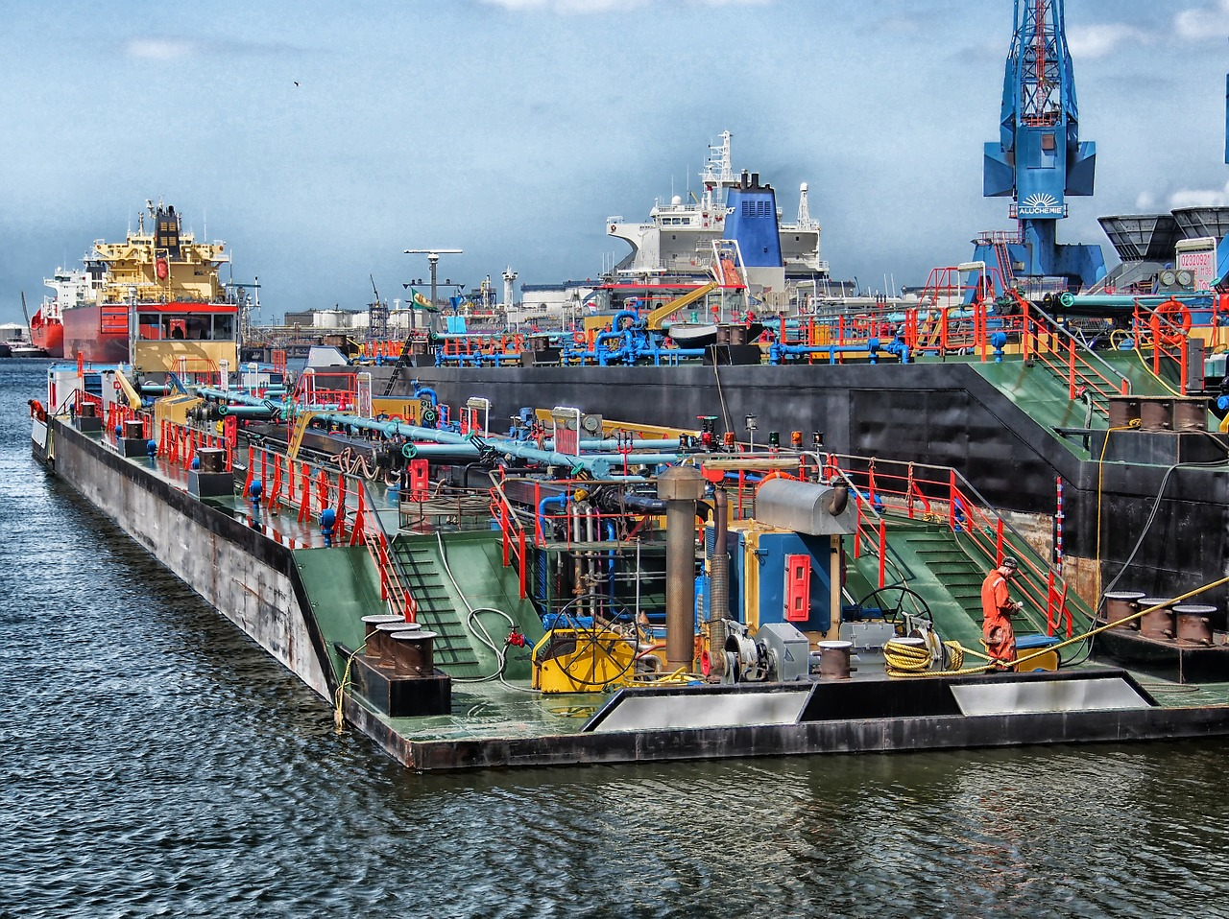
Port of Rotterdam Inland Waterways in Europe
Biggest maritime port in Europe
Annual throughput: 469,4 million tons (2019)
Throughput TEUs* 2019: 14,8 million
Port area: 12,500 ha (land and water) – 6,000 ha business sites
30,000 seagoing vessels and 110,000 inland vessels per year
Soucrce pixabay
Source: pixabay
sources: diverse
Notes:
The port of Rotterdam is the biggest maritime port in Europe with an annual throughput of 469.4 million tons.
In 2019, 14.8 million TEU-Containers (Twenty-Foot Equivalent Unit) passed through the port of Rotterdam. The port area, stretching over 40 km, is 12,500 ha including land and water which includes a business area of 6,000 ha. 30,000 seagoing vessels and 110,000 inland vessels pass the port of Rotterdam every year. This indicated that the proximity of ports to urban areas is important to enhance an increased use of inland waterways as a transport mode.
Sources:
Port of Rotterdam, Unser Hafen: URL: https://www.portofrotterdam.com/de/unser-hafen/fakten-und-zahlen/fakten-und-zahlen-zum-hafen/gueterumschlag [24.04.2020].
Port of Rotterdam, Unser Hafen: URL: https://www.portofrotterdam.com/de/unser-hafen/fakten-und-zahlen/fakten-und-zahlen-zum-hafen/schiffe [24.04.2020].
Port of Rotterdam, Unser Hafen: URL: https://www.portofrotterdam.com/de/unser-hafen/fakten-und-zahlen/fakten-und-zahlen-zum-hafen/hafeninfrastruktur [24.04.2020]
Picture: www.pixabay.com

Slide 30
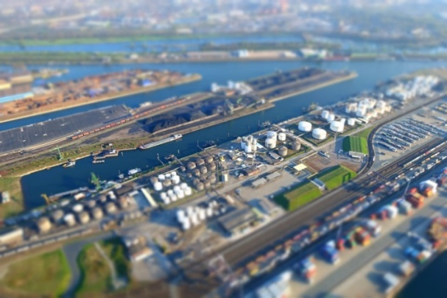
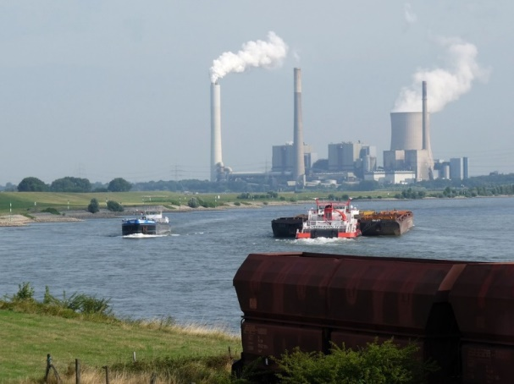
Duisport Inland Waterways in Europe
Largest trimodal inland hub in Europe → accessible by water, rail and road
Turnover: 292.2 million €/year
Basic area: 1,550 ha
Goods handled 2019:
123.7 million tons
4 million TEUs*
20,000 ships and 25,000 trains passing port
Connection to 80 destinations in Europe and Asia
Different provided services
Source: https://pixabay.com/de/hafen-industrie-schiff-wasser-770732/
Source: https://pixabay.com/de/duisburg-schwerindustrie-industrie-234308/
*TEU = Twenty-Foot Equivalent Unit. TEU is the measurement used for containerised goods and is equivalent to a container with the standard dimensions of 20 feet x 8.5 feet x 8.5 feet (around 33 m³).
sources: Duisport
Notes:
The German port Duisport in Duisburg is the largest trimodal inland port in Europe with a turnover of 292.2 million Euro per year. It connects water, rail and road and provides a industry and logistics area of 14 million m². In 2019, 123.7 million tons of goods and 4 million TEU were handled in the Duisburg port (incl. private company ports). 20,000 ships and 25,000 trains passed the port in 2019. Due to its favourable geographical location, Duisport provides a connection to more than 80 destinations in Europe and Asia. Because of extensive logistic expertise, different services such as container stuffing or stripping and pre-packing as well as services for industrial areas and properties are offered.
Source: Duisport, Hafeninformation: URL:
https://www.duisport.de/hafeninformation/ [24.04.2020].
Picture: www.pixabay.com

Slide 31
Quiz Inland Waterways in Europe
How many of the EU member states have access to navigable waterways?
14 c) 22
19 d) all
Notes:
How many of the EU member states have access to navigable waterways?
19

Slide 32
Agenda
Comparison
Inland Waterways in China
Inland Waterways in Europe
Competitive Factors of Inland Navigation
Inland Waterways in Brazil
Notes:
In this section of the presentation the main characteristics of inland navigation in China are presented. In addition, the most important inland waterway and the biggest inland port in China are discussed. Also key facts about the Three Gorges Dam are presented.

Slide 33
Overview Inland Waterways in China
Largest network of inland waterways
navigable length: 110,000 km
consists of over 5,000 rivers
2,000 inland ports
Geographic differences
South: larger rivers, fairway conditions are stable, ice-free all year
North: smaller rivers, fairway conditions aren‘t stable, ice in winter
Highest container transhipment compared to ports at global level
sources: diverse
Notes:
Due to the longest waterway network with a total length of 110,000 kilometres, China has the largest network of inland waterways in the world. It consist of more than 5,000 rivers. Besides big maritime ports such as Shanghai, there are about 2,000 inland ports connecting inland waterways with other modes of transport.
There are also geographic differences due to the size of China, affecting transport on inland waterways. In the South there are larger rivers with stable fairway conditions which are not affected by the appearance of ice. In contrast, rivers located in the North are smaller and show unstable fairway conditions. In addition, during winter the appearance of ice can affect inland waterway transport in this region.
Compared to other countries around the globe, China, in particular the port of Shanghai, has the highest container transhipment. In fact, in 2018, 42 million TEUs were handled in Shanghai.
Sources:
Indexmundi, URL: http://www.indexmundi.com/map/?t=10&v=116&r=as&l=en [27.04.2020]
CCNR, URL: https://www.wwinn.org/china-inland-waterways [27.04.2020].
Statista (2018): Freight traffic in China from 1980 to 2016, by transport carrier (in million metric tons). Online: https://www.statista.com/statistics/264809/freight-traffic-in-china/ [27.04.2020]
Picture: based on Statista, URL: https://de.statista.com/statistik/daten/studie/159509/umfrage/top-10-haefen-in-china-nach-containerumschlag/ [27.04.2020]

Slide 34
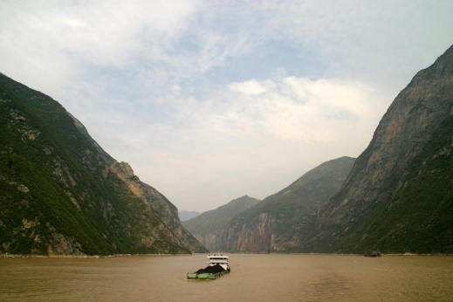
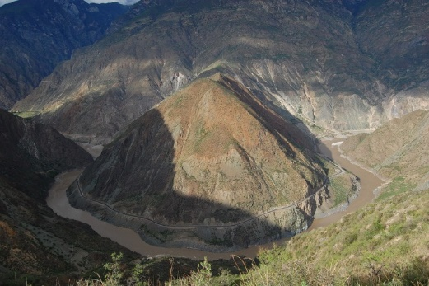
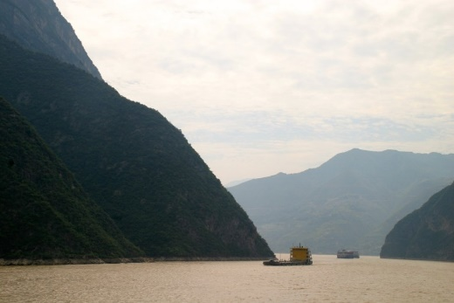
Yangtze River Inland Waterways in China
„Golden Waterway“
Route: Himalaya – Shanghai
Length: 6,300 km (3rd longest and largest river in the world)
3,000 km are navigable
Main connection between rail, road and high-sea
80% of all cargo shipping related to Yangtze
Iron ore, crude oil and coal
Important infrastructure
Ports: Chongqing, Wuhan, Shanghai, Nanjing
Three Gorges Dam
Source: pixabay
Source: https://pixabay.com/de/nu-gro%C3%9Fe-ansicht-yns-der-jangtse-888616/
Source: pixabay
Souree: pixabay
sources: diverse
Notes:
As mentioned in the slide before, the Yangtze River is the most important inland waterway for freight transport in China. Thus, it is also called the „Golden Waterway“.
Its route runs from the Himalaya to Shanghai and has a total length of 6,300 km of which 3,000 km are navigable. Therefore, it is also the 3rd longest river, after the Nile and the Amazon, and largest river in the world. The Yangtze represents the main connection between rail, road and high-sea in China, enabling a wide intermodal transport network in China. Thus, also hinterland regions, were an increasing number of industries are located, are connected to maritime ports via the Yangtze river.
Especially iron ore, crude oil and coal are mainly transported on the Yangtze river. To enable a connection to other modes of transport there are many ports of which Chongqing, Wuhan, Shanghai and Nanjing can be named as the most important ones for the Yangtze river. In addition, the famous Three Gorges Dam can be found on the Yangtze river.
Sources:
World Wide Inland Navigation Network, URL: http://www.wwinn.org/china-inland-waterways [27.04.2020]
Inland Navigation Association (PIANC), “Inland Waterborne Transport: Connecting Countries”, (2009), p.4, Online: http://www.unwater.org/downloads/181794E.pdf [27.04.2020]
Notteboom, T. (2012) Challenges for container river services on the Yangtze River: A case study for Chongqing. In: Research in Transportation Economics. Volume 35. Issue 1. Seiten 41-49.
Picture: www.pixabay.com

Slide 35
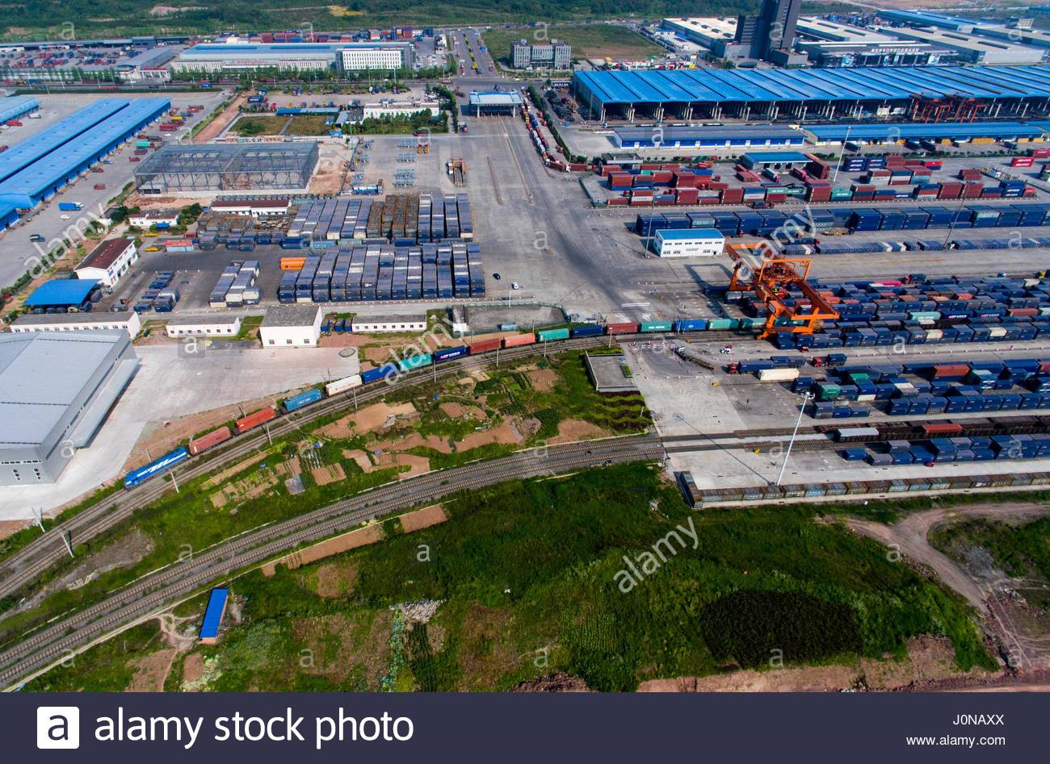
Port of Chongqing Inland Waterways in China
Terminals
Guoyuan capacity 1,2 million TEU Cuntan capacity 2 million TEU
Multimodal Infrastructure rail, road, air, waterway)
Direct railway service to Duisburg (Germany)
Dam area of the Three Gorges Dam
Connects Western China with the Eastern part of the country
sources: diverse
Notes:
The port of Chongqing is the biggest inland port of the Yangtze river. Due to its strategic location, Chongqing serves as a logistical gateway to connect Western China with the rest of the country as well as international destinations.
In fact, 90 % of the products manufactured in Chongqing and destined for export are transported via the Yangtze river. The main advantage of the port of Chongqing is that it provides a multimodal infrastructure. The goods can be transhipped in the port and can be further transported by the transport modes rail, road or air.
Sources:
Dong Yang, Kelly Yujle Wang, Hua Xu, Zhehui Zhang (2017) Path to a multi-layered transhipment port system: How the Yangtze River bulk port system has evolved. IN: Journal of Transport Geography. Volume 64. October 2017. S.54-64.
King, L., Gemmer, M., Metzler, M. (2002) Das Drei-Schluchten-Projekt am Yangtze. Gießener Forschergruppe untersucht Auswirkungen des weltgrößten Staudammprojekts. In: Spiegel der Forschung. 19. Jg./Nr.1.
Notteboom, T. (2012) Challenges for container river services on the Yangtze River: A case study for Chongqing. In: Research in Transportation Economics. Volume 35. Issue 1. Seiten 41-49.
Notteboom, T. (2017) Port governance in China since 2004: Institutional layering and the growing impact of broader policies. In: Research in transportation Business & management. Volume 22. Seiten 184-200.
Picture: www.alamy.de

Slide 36
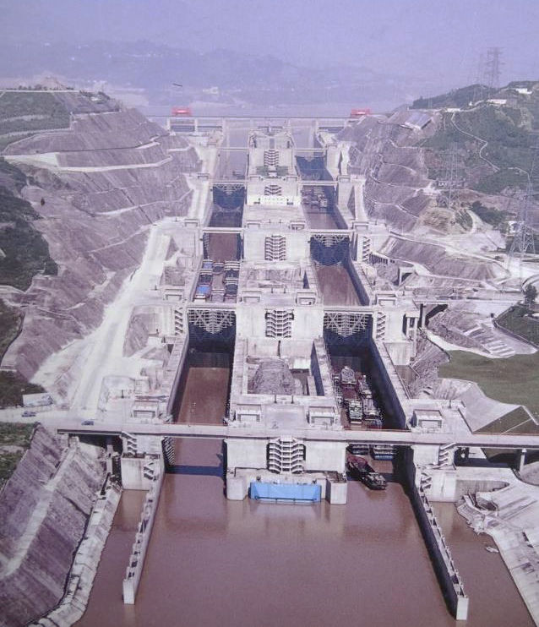
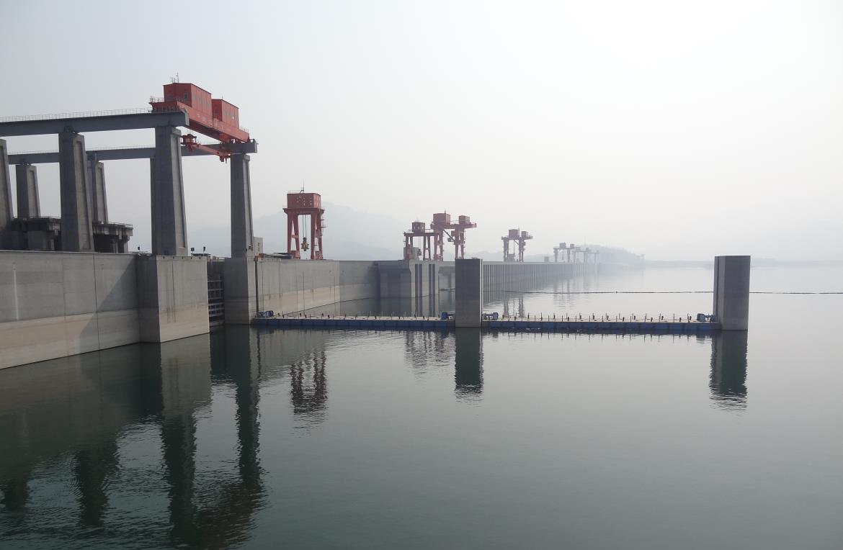
Three Gorges Dam Inland Waterways in China
aim: to control floods on the Yangtze River
length: 2.3 km, Height: 200 meters
Three Gorges refers to flooded gorges Xiling, Wu & Qutang
26 hydropower turbines (total performance: 18.2 million kilowatts )
double-way, five-step ship locks
transit time: 4 hours
one-stage vertical ship-lift
Source: Logistikum
Source: Logistikum
sources: diverse
Notes:
The three gorges dam was built to control the floods on the Yangtze River. With a length of 2.3 km and a height of 200 metres the dam is five times larger than the U.S.‘s Hoover Dam.
The name is based on the three gorges which were flooded due to the dam: Xiling, Wu and Qutang.
Besides the importance for the transport of vessels on the Yangtze river, 26 hydropower turbines contribute to the power production of China. This makes the three gorges dam the world’s largest hydropower plant. With a generated electricity of 18.2 million kilowatts the dam produces twenty times more power than the Hoover Dam. This equals about 7 % of China’s total energy demand.
The dam consists of a double-way, five-step ship lock whereas it takes 4 hours to pass the locks. Ships up to 10,000 tons are allowed to use the locks. In addition, a one-stage vertical ship-lift was built which is the largest ship-lift in the world. With this lift, it takes approximately 21 minutes (in total 1 hour) to lift a ship 113 m.
Sources:
“China's Three Gorges Dam”, URL: http
Akkermann J., Runte T., Krebs D., "Ship lift at Three Gorges Dam, China–design of steel structures.“, in Steel Construction 2, No.2, p.61-71, 2009, p.61, Online: http://probeinternational.org/library/wp-content/uploads/2011/01/Ship-lift-at-Three-Gorges-Dam-China-design-of-steel-structures.pdf [27.04.2020]
“Three Gorges Dam, China”, URL: http://www.rivercruiseadvisor.com/city-guide/asia-city-guides/china-city-guides/three-gorges-dam-china/ [27.04.2020]
Picture: Logistikum der FH OÖ GmbH

Slide 37
Quiz Inland Waterways in China
How is the Yangtze river also called?
Silver Waterway c) Blue Waterway
Golden Waterway d) Red Waterway
Notes:
How is the Yangtze river also called?
Golden waterway

Slide 38
Agenda
Comparison
Inland Waterways in China
Inland Waterways in Europe
Competitive Factors of Inland Navigation
Inland Waterways in Brazil
Notes:
In this section of the presentation the main characteristics of inland navigation in Brazil are presented. In addition, the most important inland waterway and the biggest inland port in Brazil are discussed.

Slide 39
Overview Inland Waterways in Brazil
Available waterways
Brazil: 60,000 km*
Broad river system covering almost all territorial extensions → low transport costs of transport on short transport distances
Only 22 % of inland waterways are used
Main rivers are not located at centers of production and consumption
Few investments in infrastructure
Low contribution to Brazilian economy
Mostly agricultural and mineral goods are transported
Cargo transport mainly performed by truck
* Total length of navigable rivers, canals and other bodies of water
sources: diverse
Notes:
Brazil has the most available inland waterways in South America (60,000 km). Compared to other transport modes, the broad Brazilian river system covers almost all territorial extensions. This leads to lower transport costs compared to rail and road on short transport distances.
Nevertheless, only 22 % of Brazilian inland waterways are used for freight transport. This is partly due to the fact that the main rivers are not located at the centres of production and consumption. On the other hand, compared to China and Europe, few investments are made in the inland waterway infrastructure.
As a consequence, inland navigation makes a small contribution to the Brazilian economy. By comparing the different transport modes, truck is the most frequently used transport mode for freight transport in Brazil. Goods, that are mainly transported on the inland waterways in Brazil are agricultural and mineral goods.
Sources:
Indexmundi, URL: http://www.indexmundi.com/map/?t=10&v=116&r=as&l=en [27.04.2020]
World Wide Inland Navigation Network, URL: http://www.wwinn.org/brazil-inland-waterways [27.04.2020]

Slide 40
Freight Transport Inland Waterways in Brazil
37.5 million tons/year (potential 180 million tons/year)
Main traffic routes:
Amazonas
Sao Francisco
Tocantins-Araguaia
Only 13,000 km of the total length of 60,000 km of waterways are actually used for freight transport!
sources: diverse
Notes:
Currently about 37.5 million tons of goods are transported on inland waterways in Brazil. As mentioned in the previous slide, only 22 % of the inland waterways are currently used for freight transport. The potential transport volume of inland waterways in Brazil could reach 180 million tons per year.
There are three main inland waterway traffic routes: the Amazonas, the Sao Francisco and the Tocantins-Araguaia. The main products transported on Brazilian inland waterways are soya, corn, iron ore and petroleum.
Sources:
World Wide Inland Navigation Network, URL: http://www.wwinn.org/brazil-inland-waterways [27.04.2020]
Picture: based on Ministero de Infrastructura: Anuario Estatistico de Transportes 2010-2018 URL: https://issuu.com/bit_mtpa/docs/anuario_estatistico_2010_2017_web [27.04.2020]

Slide 41
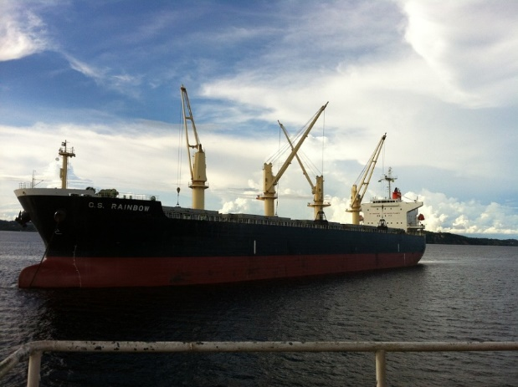
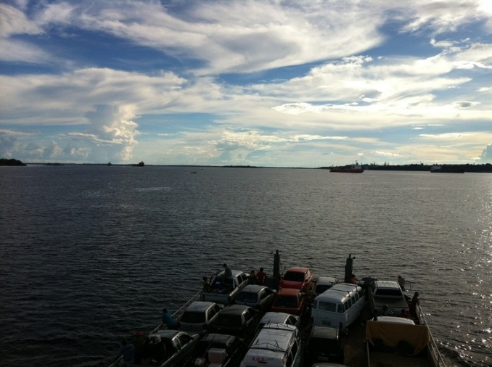
Amazonas Inland Waterways in Brazil
Longest river in the world (6,280 km)
Route: from Peru, through Brazil to Atlantic Ocean
Tropical rain forest at Amazon basin
Thefts
$ 27 million lost in Amazonas region (2015)
theft of vessels or attacks
hiding in rain forest
Source: https://pixabay.com/de/amazonas-wasser-blauer-himmel-36158/
Source: https://pixabay.com/de/amazonas-wasser-blauer-himmel-36148/
sources: diverse
Notes:
The Amazonas has a length of 6,280 km and is the longest river in the world. The route runs from Peru through northern Brazil to the Atlantic Ocean.
The banks of the Amazonas mostly consist of a tropical rainforest. This leads to the threat of theft – in fact, 27 million dollars were lost in the Amazonas region in 2015 due to thefts. Vessels can be easily attacked or stolen and thieves can easily hide in the tropical rain forests.
Sources:
World Wide Inland Navigation Network, URL: http://www.wwinn.org/brazil-inland-waterways [28.04.2020].
“Amazon River”, URL: http://www.thefreedictionary.com/Transport+on+the+Amazon [28.04.2020]
Picture: www.pixabay.com

Slide 42
Port of Manaus Inland Waterways in Brazil
Main transport hub for upper Amazon Basin
Cargo volume: 11.8 million tons/year (2007)
Total trade volume: 4.92 billion US$ (2007)
492,000 TEU handled in 2014 (+ 24.6% compared to 2013)
Main cargos:
loading: fruit, seeds, machinery, wood, fuels
unloading: machinery and electrical goods, vehicles, chemicals, plastics
Tax benefits
sources: diverse
Notes:
The port of Manaus is the main transport hub for transports on the upper part of the Amazon Basin. The cargo volume per year is 11.8 million tons. In 2007, the total trade volume of the port of Manaus was 4.92 billion US dollar, whereas exports accounted for 1.15 billion US dollars.
In 2014, 492,000 TEUs were handled in the port of Manaus which equals an increase of 24.6 % compared to the previous year.
Fruits, seeds, machinery, wood and fuels are products which were mainly loaded in the port of Manaus. Machinery and electrical goods, vehicles, chemicals and plastics can be named as products which are imported. Machinery and electrical goods are mainly imported due to the Manaus’ industrial tax free zone. In this zone companies, in particular in the electrical and electronic sector, enjoy federal tax breaks.
Sources:
Ministry of External Relations, „An ocean of Opportunities“, in: Brazil, November 2008, p. 4-12., p.11, Online: https://repositories.lib.utexas.edu/bitstream/handle/2152/13799/PUBRevistaBrasilMEPortosI.pdf [27.04.2020]
World Port Source, “Port of Manaus”, URL: http://www.worldportsource.com/ports/review/BRA_Port_of_Manaus_3506.php [27.04.2020]
“Container terminals in jungle city of Manaus face growing pains”, URL: http://www.joc.com/port-news/south-american-ports/container-terminals-jungle-city-manaus-face-growing-pains_20150702.html [27.04.2020]

Slide 43
Quiz Inland Waterways in Brazil
How long are the available waterways in Brazil?
30.000 km c) 50.000 km
40.000 km d) 60.000 km
Notes:
How long are the available waterways in Brazil?
50.000 km

Slide 44
Agenda
Comparison
Inland Waterways in China
Inland Waterways in Europe
Competitive Factors of Inland Navigation
Inland Waterways in Brazil
Notes:
In the last part of this presentation important content of the previous slides is summarized and inland navigation in Europe, China and Brazil is compared.

Slide 45
Comparison
 | Europe | China | Brazil
Available waterways | 40,000 km | 110.000 km | 60,000 km
Important waterway in region | Rhine-Main-Danube Corridor | Yangtze-River | Amazon
Transported volume on waterways in total | 544 million tons | 51,527.63 million tons | 37.5 million tons
Transported goods | dry & bulk cargo, construction material | dry & bulk cargo, construction material | mainly agricultural and mineral goods
Important inland ports in region | Duisport | Chongqing | Manaus
Importance of inland navigation in region (political/economical) | High | High | Low
Notes:
All numbers discussed in the previous slides are summarized in the table above. As can be seen in the table, the numbers significantly differ from each other. China has the most available waterways, the highest transported volume on waterways and the highest volume handled in ports compared to Europe and Brazil. Even though Brazil has more available waterways than Europe, around 12 times more volume is transported on European inland waterways.
These differences can be seen in context with the importance of inland navigation in the different countries/region. In Europe and China, inland waterways are seen as important transport modes and various measures are used to increase the use of inland waterways. Besides financial support, promotional actions can be named as examples of such measures. In this context, investments in the waterway infrastructure can be seen as a main measure to guarantee the competitiveness of inland navigation.

Slide 46
Modal Split Comparison
Definition: share of different transport modes out of the total freight traffic
* Pipeline and Air → 4 %
sources: diverse
Notes:
When comparing the modal split of Europe, China and Brazil one may say that transport by road is the most frequently used transport mode in all three countries/regions. In accordance with the previous slides, the share of inland navigation in the modal split is the highest in China.
Even though the share of inland navigation in the modal split in Brazil is higher than in Europe, more volume is transported on the inland waterways in Europe. This may be explained by the different total freight volume in Europe and Brazil.
Sources:
Eurostat, “Freight transport statistics – modal split”, (2018), URL: http://ec.europa.eu/eurostat/statistics-explained/index.php/Freight_transport_statistics_-_modal_split [28.04.2020]
Sustainable Development Department, “How to decrease freight logistics costs in Brazil”, (2010), p.60/61, Online: http://siteresources.worldbank.org/BRAZILINPOREXTN/Resources/3817166-1323121030855/FreightLogistics.pdf?resourceurlname=FreightLogistics.pdf [27.04.2020]
Statista (2020): Freight traffic in China from 1980 to 2018, by transport carrier (in million metric tons). Online: https://www.statista.com/statistics/264809/freight-traffic-in-china/ [27.04.2020]

Slide 47
Comparison
Length of available waterways
Picture Source: https://pixabay.com/de/erde-blauer-planet-erdkugel-planet-11015/
Europe
Brazil
China
Notes:
In addition, the following comparison of Brazil, China and Europe can be made:
When comparing the length of available waterways, the length of European waterways equals the circumference of the earth, which is about 40,000 km. The length of Brazilian waterways equals 1.25 times the circumference of the earth. The length of the waterways in China equals three times the circumference of the earth.

Slide 48
Conclusion Competitive Factors of Inland Navigation
Infrastructure main competitive factor for inland navigation
navigable waterways
fairway, bridges and ports
maintenance
Factors influencing Infrastructure
political/economic framework
topography
weather
proximity to urban centres
Notes:
In conclusion, the waterways infrastructure can be named as the main competitive factors of inland navigation. Even if a lot of waterways are available in a country or region, infrastructure and its maintenance is required to guarantee the navigability of waterways. In this context the fairway, bridges and ports can be named as important infrastructure elements: The fairway and bridges have a main influence on the transport on the waterway whereas ports guarantee that inland waterways are connected to other modes of transport and that goods can be transhipped. To guarantee safety and an increased use of inland waterways, regular maintenance of the infrastructure is required.
The political and economic framework can be crucial to enable measures such as investments in the waterway infrastructure. In addition, the topography and in this context the available waterways can also be named as important factors. Also the weather conditions can be different due to geographic locations and have different influence on the transport on inland waterways. The proximity to urban centres can also be named as an important external factor for the competitiveness of inland navigation. When ports are situated nearby important economic regions, it is more likely that companies will use inland waterways for transportation.

Slide 49
Quiz Comparison
Which country does have the longest available waterways?
Europe
China
Brazil
Notes:
Which country does have the longest available waterways?
China

Slide 50
Internet Research Final Exercise 1
Search the Internet for more detailed information on the
inland waterways in a country of your choice and prepare
a short presentation for your colleagues.
Notes:
This exercise is suitable as an individual exercise or to be solved in small groups up to 3 participants.
Duration: 40 min

Slide 51
ABC-List Final Exercise 2
Create an ABC-list of the most important terms of the topic “International waterways”.
Take a piece of paper, write down the ABC on the longer side of the paper.
Afterwards, you write down important terms of the topic “International waterways” for every letter. In each line you write down terms, which start with the letter of that line for example D … Danube.
At the end you will have a collection of all the important terms regarding the topic “International waterways”.
Notes:
This exercise is suitable as a individual exercise or to be solved in small groups up to 3 participants.
Duration: 20 min

Slide 52
Sources A to E
“Amazon River”, URL: http://www.thefreedictionary.com/Transport+on+the+Amazon [28.04.2020]
Central Commission for the navigation of the Rhine, “Information on the waterway Rhine”, URL: http://www.ccr-zkr.org/12030100-en.html [24.04.2020]
Central Commission for the navigation of the Rhine, “Market observation for inland navigation in Europe”, (2008), p.11/12, Online: http://www.ccr-zkr.org/files/documents/om/om07I_en.pdf [24.04.2020]
Chen Y., Matzinger S., Woetzel J., “Chinese infrastructure: The big picture”, URL: http://www.mckinsey.com/global-themes/winning-in-emerging-markets/chinese-infrastructure-the-big-picture [24.04.2020]
“China's Three Gorges Dam”, URL: http Akkermann J., Runte T., Krebs D., "Ship lift at Three Gorges Dam, China–design of steel structures.“, in Steel Construction 2, No.2, p.61-71, 2009, p.61, Online: http://probeinternational.org/library/wp-content/uploads/2011/01/Ship-lift-at-Three-Gorges-Dam-China-design-of-steel-structures.pdf [27.04.2020]
“Container terminals in jungle city of Manaus face growing pains”, URL: http://www.joc.com/port-news/south-american-ports/container-terminals-jungle-city-manaus-face-growing-pains_20150702.html [27.04.2020]
DeWoskin K., “China”, URL: http://www.britannica.com/place/China/Waterways [24.04.2020]
Duisburg Hafen AG, Hafeninformation: URL: https://www.duisport.de/hafeninformation/?lang=en [24.04.2020]
Dong Yang, Kelly Yujle Wang, Hua Xu, Zhehui Zhang (2017) Path to a multi-layered transhipment port system: How the Yangtze River bulk port system has evolved. IN: Journal of Transport Geography. Volume 64. October 2017. S.54-64.
DVZ (2019): URL: https://www.dvz.de/rubriken/see/haefen/detail/news/frankreichs-fuehrende-seehaefen-mit-2018-zufrieden.html [24.04.2020]
European Commission, “Inland Waterways”, URL: http://ec.europa.eu/transport/modes/inland/index_en.htm [24.04.2020].
Eurostat, “Freight transport statistics – modal split”, (2020), URL: http://ec.europa.eu/eurostat/statistics-explained/index.php/Freight_transport_statistics_-_modal_split [24.04.2020]
Eurostat, “Inland waterway transport statistics”, URL: http://ec.europa.eu/eurostat/statistics-explained/index.php/Inland_waterway_transport_statistics [24.04.2020]

Slide 53
Sources F to N
French Waterways, URL: https://www.french-waterways.com/waterways/north/seine-nord-europe/ [25.05.2020]
Hafen Hamburg, Statistiken: URL: https://www.hafen-hamburg.de/de/statistiken [24.04.2020].
Hafen Rotterdam, Statistiken: URL: https://www.portofrotterdam.com/de/unser-hafen/fakten-und-zahlen-zum-hafen [24.04.2020].
Indexmundi, URL: http://www.indexmundi.com/map/?t=10&v=116&r=xx&l=en [24.04.2020]
Inland Navigation Association (PIANC), “Inland Waterborne Transport: Connecting Countries”, (2009), p.4, Online: http://www.unwater.org/downloads/181794E.pdf [27.04.2020]
Inland navigation Europe, “EU waterway infrastructure priorities for 2014-2020”, URL: http://www.inlandnavigation.eu/news/infrastructure/eu-waterway-infrastructure-priorities-for-2014-2020/ [24.04.2020]
Juha Schweighofer, “The impact of extreme weather and climate change on inland waterway transport” in Natural Hazards, May 2014, Volume 72, Issue 1, p 23-40, p. 25.
King, L., Gemmer, M., Metzler, M. (2002) Das Drei-Schluchten-Projekt am Yangtze. Gießener Forschergruppe untersucht Auswirkungen des weltgrößten Staudammprojekts. In: Spiegel der Forschung. 19. Jg./Nr.1.
Ministero de Infrastructura: Anuario Estatistico de Transportes 2010-2018 URL: https://issuu.com/bit_mtpa/docs/anuario_estatistico_2010_2017_web [27.04.2020]
Ministry of External Relations, „An ocean of Opportunities“, in: Brazil, November 2008, p. 4-12., p.11, Online: https://repositories.lib.utexas.edu/bitstream/handle/2152/13799/PUBRevistaBrasilMEPortosI.pdf [27.04.2020]
Notteboom, T. (2012) Challenges for container river services on the Yangtze River: A case study for Chongqing. In: Research in Transportation Economics. Volume 35. Issue 1. Seiten 41-49.
Notteboom, T. (2017) Port governance in China since 2004: Institutional layering and the growing impact of broader policies. In: Research in transportation Business & management. Volume 22. Seiten 184-200.

Slide 54
Sources O to S
Observatory of European inland navigation, URL: http://www.inland-navigation.org/river/rhine/ [24.04.2020]
Pastori E., “Modal share of freight transport to and from EU ports”, (2015), p.29, Online: http://www.europarl.europa.eu/RegData/etudes/STUD/2015/540350/IPOL_STU(2015)540350_EN.pdf [24.04.2020].
Port of Antwerp: Statistisches Jahrbuch 2019, URL: https://www.portofantwerp.com/sites/portofantwerp/files/Statistisch%20Jaarboek%202019_1.pdf [24.04.2020].
Port de Liege, URL: http://www.portdeliege.be/assets/1a412596-e779-42c7-bfe8-50a9f450fb1f/20150304-CP-Trafics-2014_FINAL.pdf [24.04.2020].
Port of Constantza, Statistiken: URL: https://www.portofconstantza.com/pn/page/np_statistici_port [24.04.2020].
Port of Galati, Statistiken: URL: http://www.romanian-ports.ro/html_nou/traficapdm.php# [24.04.2020]
Quispel M., “Medium and long term perspectives of Inland Waterway Transport in the European Union”, Online: http://ec.europa.eu/transport/modes/inland/events/doc/2011-07-05-naiades-stakeholder/2011-07-05-presentation-perspectives.pdf [24.04.2020]
´Statista (2018): Freight traffic in China from 1980 to 2016, by transport carrier (in million metric tons). Online: https://www.statista.com/statistics/264809/freight-traffic-in-china/ [27.04.2020]
Statista, URL: https://de.statista.com/statistik/daten/studie/159509/umfrage/top-10-haefen-in-china-nach-containerumschlag/ [27.04.2020]
Statista (2020): Freight traffic in China from 1980 to 2018, by transport carrier (in million metric tons). Online: https://www.statista.com/statistics/264809/freight-traffic-in-china/ [27.04.2020]
Sustainable Development Department, “How to decrease freight logistics costs in Brazil”, (2010), p.60/61, Online: http://siteresources.worldbank.org/BRAZILINPOREXTN/Resources/3817166-1323121030855/FreightLogistics.pdf?resourceurlname=FreightLogistics.pdf [27.04.2020]

Slide 55
Sources T to Z
“Three Gorges Dam, China”, URL: http://www.rivercruiseadvisor.com/city-guide/asia-city-guides/china-city-guides/three-gorges-dam-china/ [27.04.2020]
viadonau, “Good Practice Manual on Inland Waterway Maintenance. Focus: Fairway maintenance of free-flowing rivers”, (2016) p.6, Online: http://www.savacommission.org/dms/docs/dokumenti/documents_publications/platina/platina_2_manual_on_waterway_maintenance_final.pdf [26.04.2020].
viadonau (2019): Manual on Danube Navigation, Vienna.
viadonau (2021): Annual report on Austrian Danube Navigation, Vienna.
World Port Source, “Port of Manaus”, URL: http://www.worldportsource.com/ports/review/BRA_Port_of_Manaus_3506.php [27.04.2020]
World Wide Inland Navigation Network, URL: http://www.wwinn.org/china-inland-waterways [24.04.2020]
World wide inland navigation network, URL: http://www.wwinn.org/the-rhine [24.04.2020]
World Wide Inland Navigation Network, URL: http://www.wwinn.org/brazil-inland-waterways [27.04.2020]
Zentralkommission der Rheinschifffahrt, Marktbeobachtung 2019, URL: https://inland-navigation-market.org/wp-content/uploads/2019/11/ccnr_2019_Q2_de-min2.pdf.pdf [24.04.2020].
Zentralkommission für die Rheinschifffahrt, “Jahresbericht 2016 Europäische Binnenschifffahrt Marktbeobachtung”, URL:https://www.ccr-zkr.org/files/documents/om/om16_II_de.pdf [26.07.2018]

Slide 56
Further Information
We hope our set of slides has met your expectations!
- you are free to use, adapt and share this slides and to use it for your lectures.
For questions and feedback please do not hesitate to contact us:
rewway@fh-steyr.at
Further set of slides are available at:
http://www.rewway.at/en/teaching-materials/bundles/
Maybe you are interested to book a Transport School Lab, a guest lecture or an excursion?
http://www.rewway.at/en/services/

