Slide 1
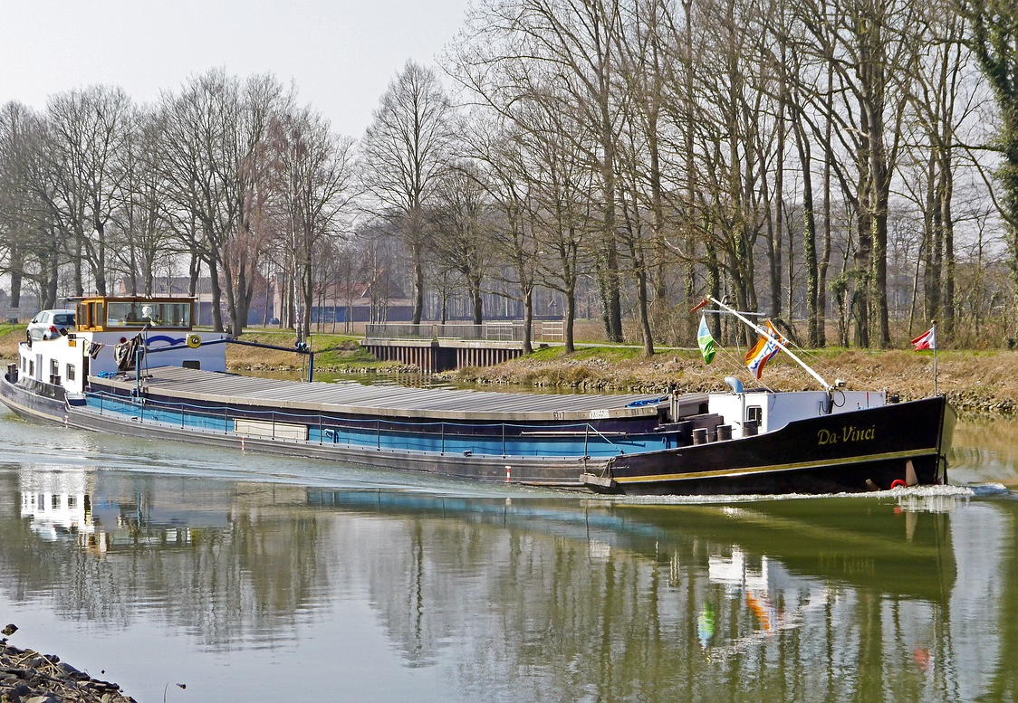
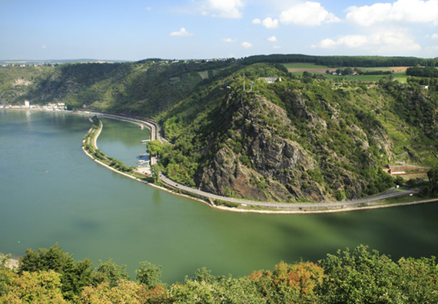
Panel Discussion „Green Logistics“
source: pixabay
source: Planet Wissen

Slide 2
Scenario Panel Discussion Green Logistics
Sustainability is becoming increasingly important in all areas of life, including logistics and transport.
Due to the currency of the issue, a conference on "Green Logistics" will be held with a panel discussion of experts.
In addition to Green Logistics, the connection with inland waterways as an environmentally friendly transport alternative will also be discussed.
You are experts participating in the panel discussion and represent the different modes of transport.

Slide 3
Green Logistics?
„Green Logistics is a form of logistics which is calculated to be environmentally and often socially friendly in addition to economically functional.” Rituray Saroha (2014)
Costs
Unproductivity
Green Logistics
Goals
Econom-ically fuctional
Environmentally friendly
Socially friendly
Two videos that explain Green Logistics in more detail can be found on YouTube at
https://www.youtube.com/watch?v=E5ywje44-tg
https://www.youtube.com/watch?v=MX2N8uATfzs
emission
Resource consumption
Awareness
Quality of life
Quelle: diverse
Notes:
http://www.ripublication.com/iraer-spl/iraerv4n1spl_14.pdf
https://www.youtube.com/watch?v=E5ywje44-tg
https://www.youtube.com/watch?v=MX2N8uATfzs
https://www.youtube.com/watch?v=zKOkEEmtlIo

Slide 4
Procedure Panel Discussion Green Logistics
Step 1: Divide into groups
Step 2: Assignment of roles
Each group prepares a role (information about the roles can be found on the next slide)
Step 3: Preparation (45-60 minutes)
Prepare for discussion.
Step 4: Discussion
Now that you are well prepared, it is time for your discussion. As soon as it is decided who represents which group, you can start.
Divide into groups of equal size.
The group size should be 4-5 people depending on the total number of participants.
Together, prepare arguments and inputs appropriate to your role.
Which member of the group will participate in the discussion is decided randomly.
On one of the next slides you will find a few short suggestions for the roles

Slide 5
Assignment of roles Panel discussion Green Logistics
Possible roles:
Moderator
Expert road transport
Expert rail transport
Expert inland waterway transport
Expert air transport
Each group jointly prepares arguments and inputs for discussion according to their assigned role. Which group member represents the group in the discussion is decided randomly, i.e. by lots.
source: pixabay

Slide 6
Preparation Panel Discussion Green Logistics
Preparation time 45-60 minutes
Here are a few brief suggestions for the individual roles:
Moderator | Expert
Short introduction of the participants As an introduction, briefly explain "Green Logistics” Prepare short questions for the individual participants (in case discussion is stalled) Ensure that all discussion participants are equally involved | Prepare key data for the presentation by the moderator Introduce your mode of transport briefly. Look for interesting facts and data on the individual modes of transport in Europe and worldwide (focus on freight mobility) What effects (both positive and negative) does Green Logistics have in your area? How well does your mode of transport fit into the Green Logistics concept?

Slide 7
Further Information
We hope our exercise has met your requirements!
- You are welcome to adapt the set of slides according to your wishes and requirements and use it for your lessons/lectures.
This exercise is part of a teaching material package, including a PowerPoint slide set, a video library, a link collection and three additional exercises.

