Slide 1
How to work with this learning material
Power Point
The following power point presents legal aspects. The slides are described in the notes below and you can also find the link to the source if you need further information.
Reader
In addition to the power point presentation, you can also use the reader provided on our platform. It’s more detailed and can be used as a script for your lessons.
Links
You can also find the sources of our presentation and reader in the links section of the relevant bundled teaching material.

Slide 2
Learning objectives and target groups
After having studied the contents, the learners know…
Relevant legal regulations for navigating national and European waterways, as well as the classification of waterways
European and national promotion strategies to strengthen inland navigation and sustainable freight transport
Important legal regulations and agreements and know the basics about transport options, transport contracts and liability issues
the basics of crew requirements ad types of propulsion and are familiar with the relevant regulations on fuels and emissions, as well as the transport of hazardous goods
Target group
University students
Vocational students
High School students

Slide 3
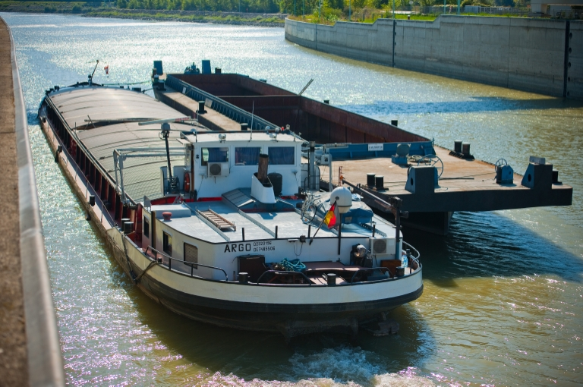
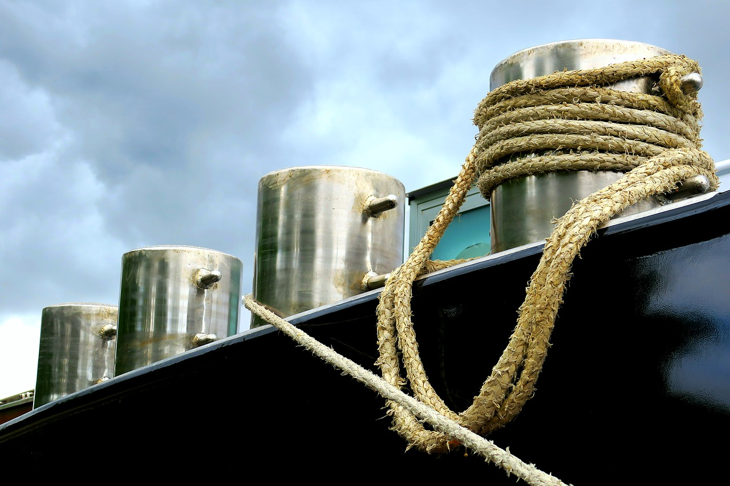



LEGAL ASPECTS
source: via donau
source: pixabay
Notes:
This set of slides provides an overview of the legal aspects of inland navigation. Among others, the document contains information on the promotion of inland navigation, on the legal aspects of inland waterways as well as of inland vessels as transport mode, starting from the freight contract to liability issues to the crew and technical equipment.

Slide 4

Warm-Up Legal aspects
Quelle: pixabay
Who creates the transport policy in Europe?
What is the European Green Deal and what is its goal?
Notes:
The questions mentioned in the slide above can be used as a warm up exercise for the topic “Legal aspects”. The aim is to discuss the questions in plenum with students. Answers to the questions will be provided during the presentation. Therefore, the questions can be discussed again at the end of the presentation.
Discussion questions (5-10 Minute Discussion):
Who creates the transport policy in Europe?
European Union, the states individually
What is the European Green Deal and what is its goal?
The goal of the European Union is to become worlds first climate-neutral continent until 2050. Therefore an action plan with key actions was elaborated to reach this goals.
Further information on slide 18 and 19

Slide 5
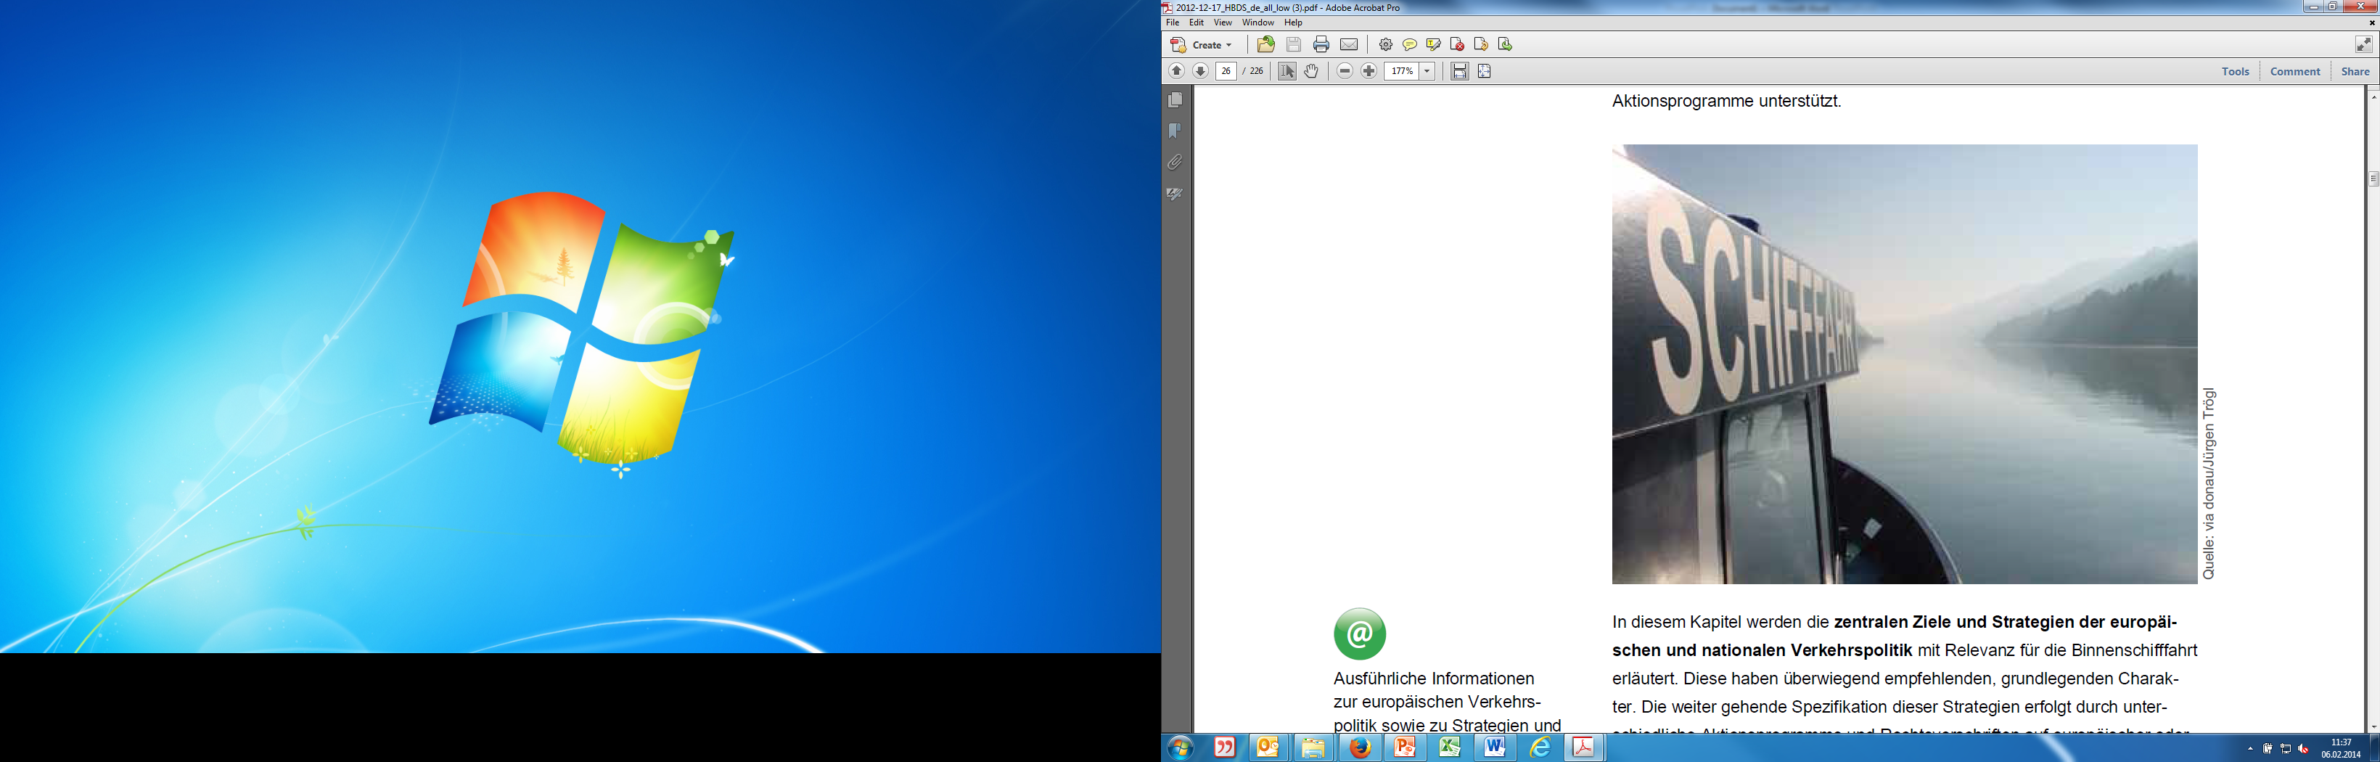
Overview Legal Aspects
Wide-ranging legal aspects:
regulations concerning European inland waterways
promotion of inland navigation and combined transport
legal aspects when shipping an inland vessel:
minimum number of crew members and maximum travelling times
pollution levels
excursus: transportation of hazardous goods
source: pixabay
source: viadonau/ Jürgen Trögl

Slide 6
Legal Aspects
Inland Waterways
Freight Transport by Inland Vessel
Inland Vessels – Crew, Equipment, Drive
Promotion of Inland Navigation

Slide 7
Pan-European Level - Belgrade Convention Inland Waterways
„Convention Regarding the Regime of Navigation on the Danube“
signed by all Danube riparian states
main targets:
safeguard the freedom of navigation on the Danube for all states
oblige the Danube states to maintain their sections of the Danube waterway to a navigable condition
implementation of the Belgrade Convention supervised by the Danube Commission: (www.danubecommission.org)
makes recommendations (e.g. concerning fairway conditions)
provides a system of uniform symbols and traffic regulations
harmonized regulations for monitoring the Danube waterway
Notes:
The Convention Regarding the Regime of Navigation on the Danube was signed by all Danube riparian states (‘Belgrade Convention’ of 1948). Its main objectives are to safeguard the freedom of navigation on the Danube for all states as well as to oblige the Danube states to maintain their sections of the Danube waterway to a navigable condition.
The implementation of the Belgrade Convention, together with adherence to its provisions, is supervised by the Danube Commission which is based in Budapest. The Commission is made up of the signatory states of the Belgrade Convention.
Source: viadonau, Manual on Danube Navigation, page 29.

Slide 8
Belgrade Convention - Freedom for Shipping Inland Waterways
shipping on the Danube free of charges and without authorization
thus, no canal and locking fees (classification as international waterway)
locking 24 hours per day and 7 days per week free of charge
fees for shipping the Main-Danube-Canal and the Danube-Black Sea Canal (national Waterway – not included in Belgrade Convention)
Notes:
As the section of the Danube from Kelheim to Sulina is defined as an international waterway, in compliance with the ‘Convention Regarding the Regime of Navigation on the Danube’ dated 18 August 1948 (Belgrade Convention), and can therefore be used free of charge by navigation, it is not subject to any navigation dues. The 63-km Sulina Canal used almost exclusively by sea-river or seagoing vessels is an exception. The Romanian River Administration of the Lower Danube charges dues calculated per ton deadweight of a vessel for maintenance purposes.
The authorities charge dues for infrastructure maintenance on national waterways that do not fall under the Belgrade Convention. This applies to the Ukrainian Bystroe arm (maritime stretch of the Danube) and to the Romanian Danube-Black Sea Canal (links the Danube to the Black Sea and the seaport of Constanța at Cernavodă).
Source: viadonau, Manual on Danube Navigation, page 171.

Slide 9
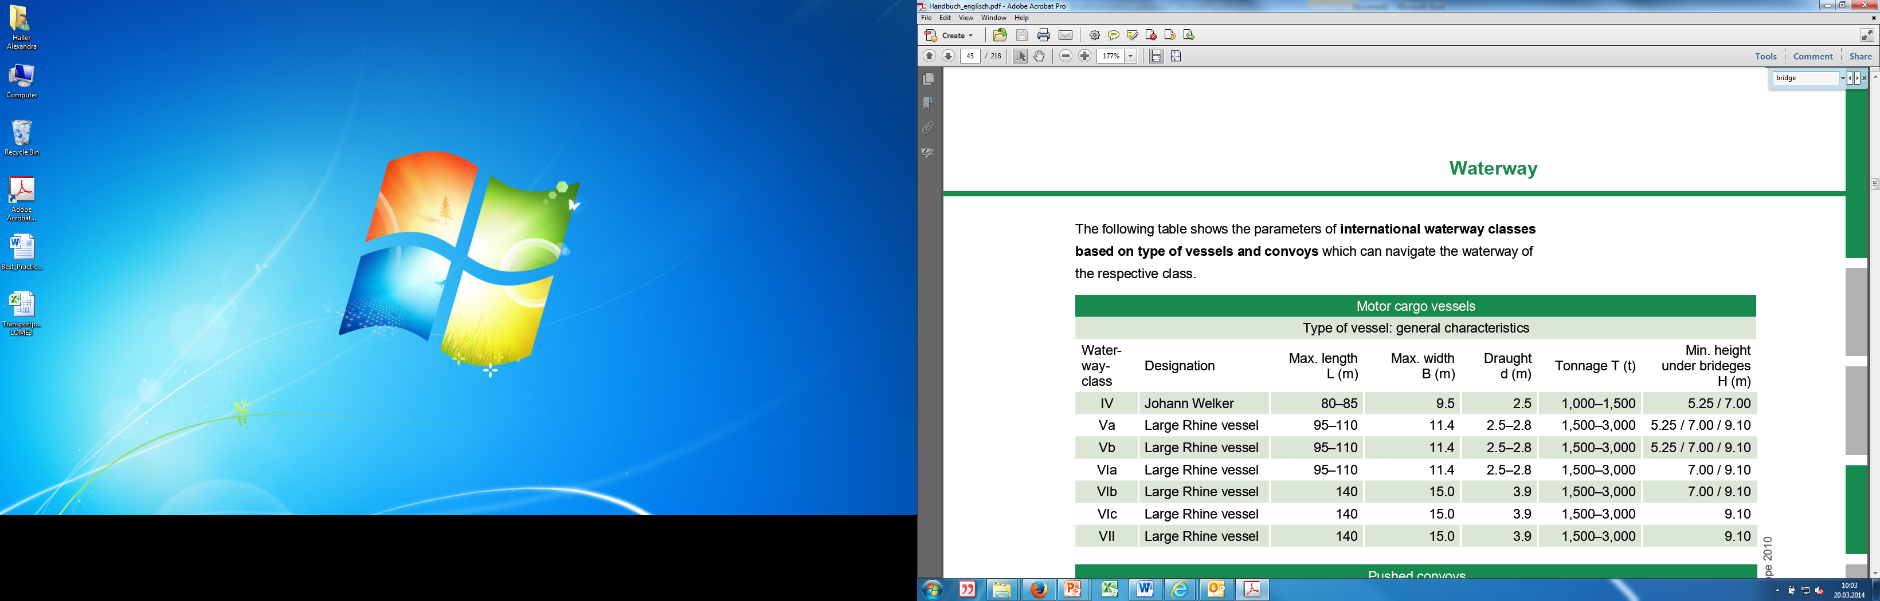
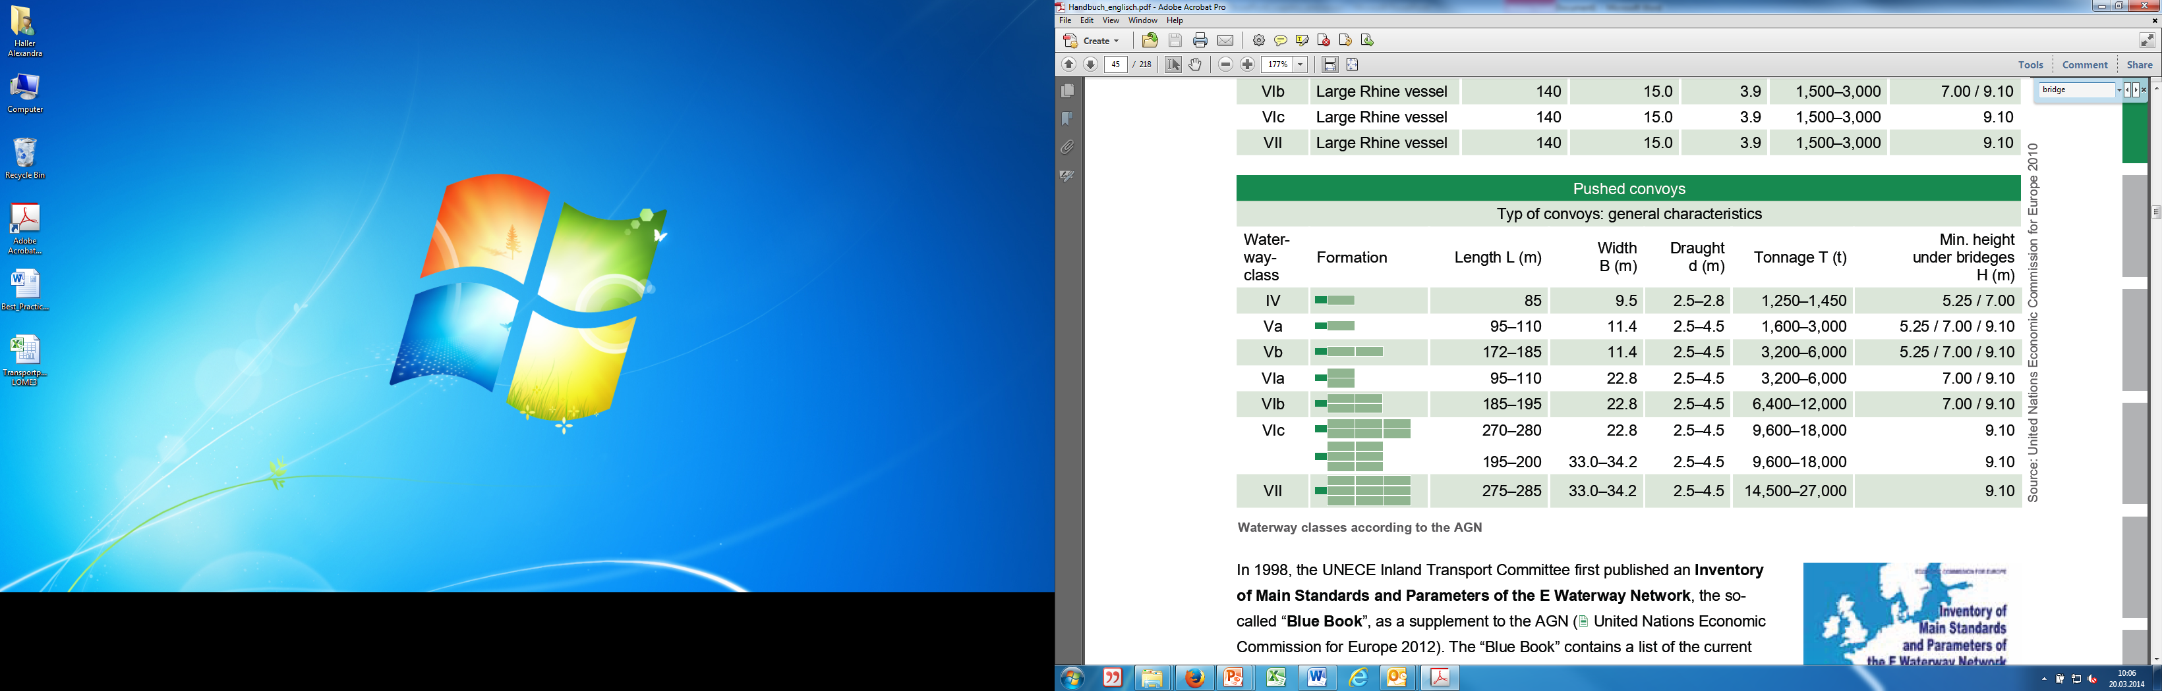
Excursus: Classification of Inland Waterways
important for transport organization: which waterways can be used by which inland vessel?
maximum draught, bridge clearance
classes of waterways (class ≥IV as waterways of International importance)
ship’s certificate in order to confirm, which waterways can be used by the ship
waterways are classified by AGN (= European Agreement on Main Inland Waterways of International Importance)
source: United Nations Economic Commission for Europe 2010
Notes:
A waterway is a body of surface water serving as a route of transport for goods and/ or passengers by means of vessels. Navigable inland transport routes are called inland waterways. Natural inland waterways are provided by rivers and lakes, whereas canals are artificial waterways.
In order to create the most uniform conditions possible for the development, maintenance and commercial use of Europe’s inland waterways, in 1996 the Inland Transport Committee of the United Nations Economic Commission for Europe (UNECE) adopted the European Agreement on Main Inland Waterways of International Importance (AGN) ( United Nations Economic Commission for Europe, 2010). The Agreement, which came into force in 1999, constitutes an international legal framework for the planning of the development and maintenance of the European inland waterway network and for ports of international importance, and is based on technical and operational parameters.
By ratifying the Agreement, the contracting parties express their intention to implement the coordinated plan for the development and construction of the so-called E waterway network. The E waterway network consists of European inland waterways and coastal routes which are of importance for international freight transport, including the ports situated on these waterways.
E waterways are designated by the letter ‘E’ followed by a number or a combination of numbers, whereby main inland waterways are identified by two-digit numbers and branches by four- or six-digit numbers (for branches of branches). The international waterway of the Danube is designated as E 80, and its navigable tributary the Sava, for example, as E 80-12.
Waterway classes are identified by Roman numbers from I to VII. Waterways of class IV or higher are of economic importance to international freight transport. Classes I to III identify waterways of regional or national importance.
The class of an inland waterway is determined by the maximum dimensions of the vessels which are able to operate on this waterway. Decisive factors in this respect are the width and length of inland vessels and convoys, as they constitute fixed reference parameters. Restrictions regarding the minimum draught loaded of vessels, which is set at 2.50 metres for an international waterway, as well as the minimum height under bridges (5.25 metres in relation to the highest navigable water level) can be made only as an exception for existing waterways.
The table above shows the parameters of international waterway classes based on type of vessels and convoys which can navigate the waterway of the respective class.
Source: viadonau, Manual on Danube Navigation, page 42-43.

Slide 10


Quiz Inland waterways
What is the Belgrade Convention??
Convention on the Regulation of Navigation on the Danube
Division of waterways into classes
Regulation of the tasks and organisation of the Austrian Federal Waterways Administration
detailed rules for navigating Austrian waterways
Source: pixabay
Source: pixabay
Notes:
What is the Belgrade Convention?
Convention on the Regulation of Navigation on the Danube

Slide 11
Legal Aspects
Inland Waterways
Freight Transport by Inland Vessel
Inland Vessels – Crew, Equipment, Drive
Promotion of Inland Navigation

Slide 12
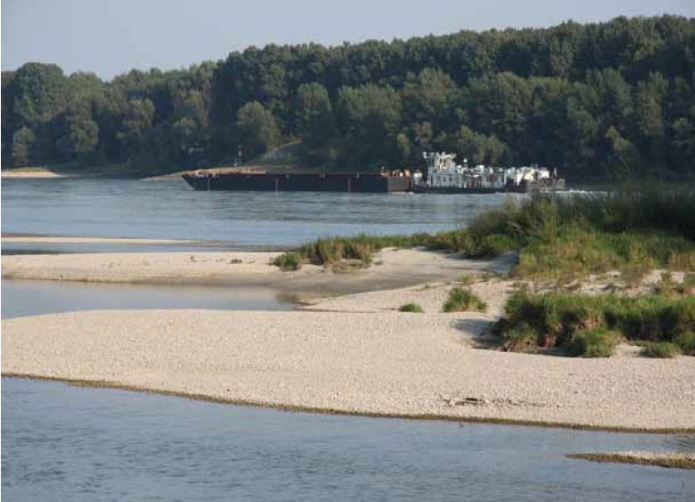

Promotion of Inland Navigation
National and international Transport Policy
sets direction for further development by:
defining basic targets and strategies
establishing infrastructural projects
source: via donau/Robert Trögel
Win-Win for navigation and ecology by integrative waterway infrastructure projects on the Danube
Important: Teamwork between the Danube riparian states
source: viadonau
Notes:
The future development of the mobility system is defined by national and European transport policies. This is achieved by determining basic objectives and strategies as well as by their implementation in important infrastructure and innovation projects. Based on this, the co-functioning of transport modes is promoted and negative consequences of mobility are reduced
Source: viadonau, Manual on Danube Navigation, page 24.

Slide 13

Transport Policy - on Pan-European Level Promotion of Inland Navigation
Past: EU-Strategy Europe 2020 (European Commission, 2010a)
definition of main transport policy targets and strategies
e.g. reduce greenhouse gas emissions
provides policy framework for further development of inland navigation
source: pixabay
Further information on the EU-Strategy: Europe 2020
source: viadonau
Notes:
The EU strategy Europe 2020, which was adopted in 2010, describes the essential overarching (transport) policy objectives and strategies of the European Union for the year 2020. Accordingly, the strategy also provides the policy framework for the further development of inland navigation. In a rapidly changing world, the EU is aiming for growth which is:
• smart (through effective investments in education, research and innovation),
• sustainable (thanks to a decisive move towards a low-carbon economy and competitive industry) and
• inclusive (with a strong emphasis on job creation and poverty reduction).
The process was guided on the basis of five policy objectives that allow its implementation to be measured. The fields of climate change and energy together with research and development are of particular relevance to inland navigation. In the field of climate change and energy, objectives have been set to cut greenhouse gas emissions in the range of 20 to 30% in comparison to 1990, to raise the share of renewable energy to 20% and to boost energy efficiency by 20%. For research and development in Europe, 3% of the gross domestic product of the EU will be made available. The European Commission publishes ongoing monitoring reports on the indicators, which are accessible online (refer to the link in the margin).
An evaluation, unfortunately, could not be found to date.
Source: viadonau, Manual on Danube Navigation, page 26.

Slide 14
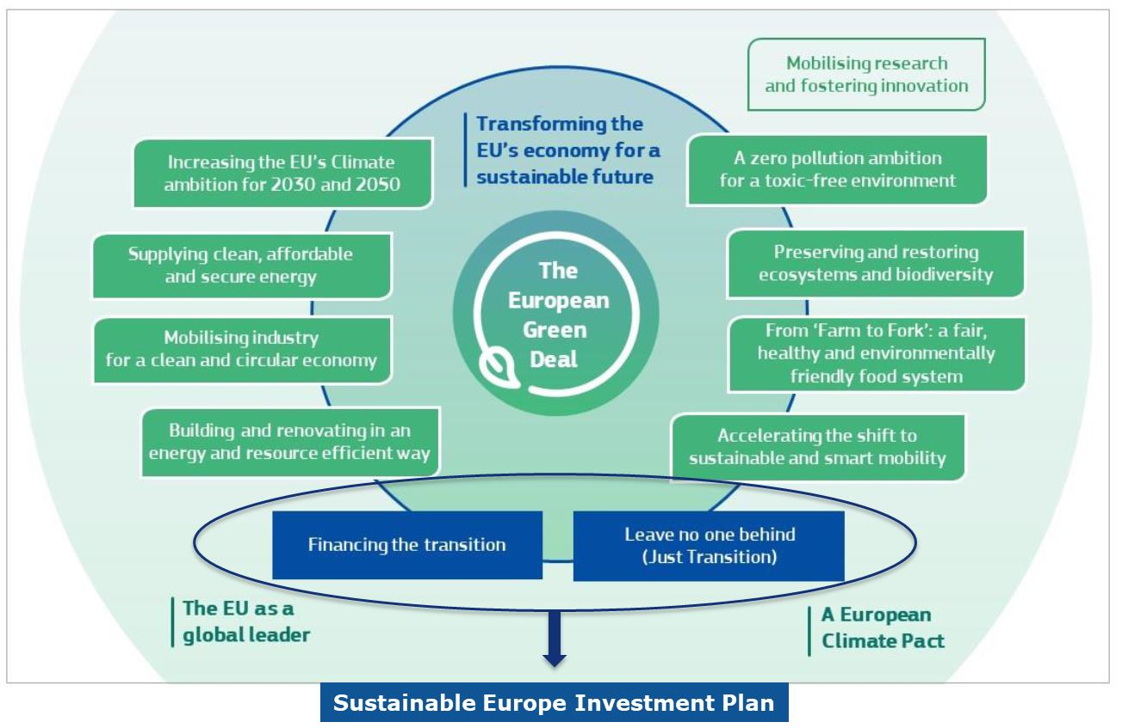
The European Green Deal
European Green Deal (European Commission, 2019)
Accelerate the shift to sustainable and smart mobility.
Reduce greenhouse gas emissions from the transport sector by 90% by 2050
Greater shift of road freight transport to rail and inland waterways
Notes:
Source: European Commission, Communication and roadmap on the European Green Deal, https://eur-lex.europa.eu/legal-content/EN/TXT/?qid=1576150542719&uri=COM%3A2019%3A640%3AFIN. [10.08.2020]

Slide 15

The European Green Deal
European Goal: Become first climate-neutral continent until 2050
An action plan with key actions was elaborated to reach this goal
Actions concerning sustainable and smart mobility e.g.:
Elaborate a new/revised proposal for a Directive on Combined Transport
Initiatives to increase capacity of railways and inland waterways
Elaborate stricter standards for air pollutant emissions for combustion-engine vehicles
Notes:
The goal of the European Union is to become worlds first climate-neutral continent until 2050. Therefore an action plan with key actions was elaborated to reach this goals.
An overview of this key action can be found in the source below. In this documents also special actions concerning sustainable and smart mobility can be found. Among others goals are to elaborate a new/revised proposal for a Directive on combined transport as well as initiatives to increase the capacity of railways and inland waterways and also to better manage them.
Additionally stricter standards for air pollutant emission for combustion-engine vehicles will be elaborated.
.
Source: European Commission, Annex to the Communication on the European Green Deal Roadmap - Key actions, https://ec.europa.eu/info/sites/info/files/european-green-deal-communication-annex-roadmap_en.pdf. [10.08.2020]

Slide 16
The European Green Deal Sustainable and Smart Mobility Strategy
End 2020: Sustainable and Smart Mobility Strategy of the Commission of the EU as part of the European Green Deal.
Goal: Reduce transport-related emissions by 90% by 2050.
Comprises 10 flagship initiatives with > 80 measures
Inland waterway transport milestone: increase inland waterway transport by 25% by 2030 and by 50% by 2050
Notes:
At the end of 2020, the Commission of the European Union published strategies for sustainable and intelligent mobility. This strategy is part of the European Green Deal and aims to reduce transport emissions by 90% by 2050. To this end, 82 measures have been defined in 10 flagship initiatives.
A milestone concerning inland navigation is the increase of inland waterway transport by 25% until 2030 and by 50% until 2050.
Source: European Commission, Sustainable and Smart Mobility Strategy – putting European transport on track for the future, https://eur-lex.europa.eu/resource.html?uri=cellar:5e601657-3b06-11eb-b27b-01aa75ed71a1.0001.02/DOC_1&format=PDF, [02.11.2022]
Bundesministerium für Klimaschutz, Umwelt, Energie, Mobilität, Innovation und Technologie, Strategie für nachhaltige und intelligente Mobilität der Europäischen Kommission, https://www.bmk.gv.at/themen/verkehr/luftfahrt/umwelttechnologien/nachhaltige_mobilitaet.html#:~:text=Ende%202020%20hat%20die%20Kommission,2050%20um%2090%20Prozent%20verringert [02.11.2022]

Slide 17
Transport Policy - on Pan-European Level Promotion of Inland Navigation
Quelle: pixabay
TEN-T Network
With the Trans-European Transport Network (TEN-T) Regulation, the EU aims to promote the development of an effective, EU-wide and multimodal transport network.
General priorities and objectives include reducing transport-related greenhouse gas emissions by 60% below 1990 levels by 2050.
Section 2, Art 14-16 deals with inland navigation in detail
Further information
Quelle: viadonau
Notes:
With the regulation on the Trans-European Transport Network (TEN-T) (REGULATION (EU) No. 1315/2013 )the EU aims to promote the development of an effective, EU-wide and multimodal transport network.
In addition to general priorities and targets, e.g. the reduction of transport-related greenhouse gas emissions by 60% by 2020 compared to 1990, inland navigation is treated separately in Section 2 in Art. 14-16. One focus is on setting priorities for the development of inland waterway infrastructure.
Source: REGULATION (EU) No 1315/2013 OF THE EUROPEAN PARLIAMENT AND OF THE COUNCIL of 11 December 2013 on Union guidelines for the development of the trans-European transport network and repealing Decision No 661/2010/EU, http://publications.europa.eu/resource/cellar/f277232a-699e-11e3-8e4e-01aa75ed71a1.0006.01/DOC_1 [02.11.2022]

Slide 18
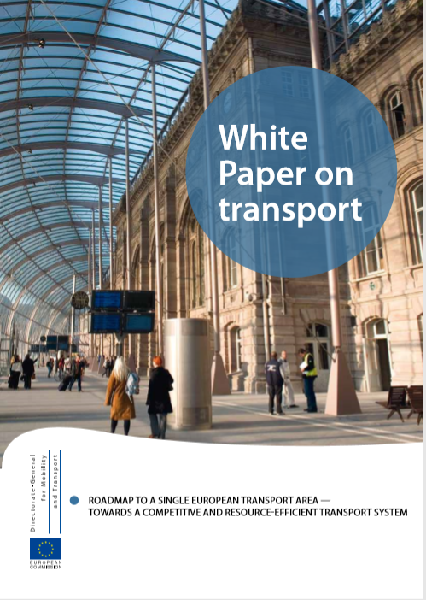
Transport Policy - on Pan-European Level Promotion of Inland Navigation
White Paper on Transport (European Commission, 2011)
targets for reducing oil dependency and CO₂ emissions:
30% of road freight over 300 km should shift to other transport modes
a fully functional and EU-wide multimodal trans-European transport network (TEN-T) shall exist
equivalent management systems for land and waterway transport (RIS) shall be deployed
inland navigation recognized as an energy-efficient transport mode
Source: https://ec.europa.eu/transport/sites/transport/files/themes/strategies/doc/2011_white_paper/white-paper-illustrated-brochure_en.pdf
Further information on the White Paper on Transport
Notes:
The European Commission’s 2011 White Paper on Transport titled ‘Roadmap to a Single European Transport Area – Towards a competitive and resource efficient transport system’ sets ambitious objectives for reducing oil dependency and CO2 emissions. The latter should be reduced by 60% by 2050 in comparison to 1990.
The White Paper recognises inland navigation as an energy-efficient transport mode and encourages the raising of its share in the modal split.
The following goals of the White Paper are specifically relevant for inland navigation:
• 30% of road freight over 300 kilometres should shift to other transport modes such as waterway transport by 2030, and more than 50% by 2050. This shall be facilita- ted by efficient and green multimodal transport corridors. The Danube is part of such a corridor within the scope of the EU’s trans-European transport network (TEN-T), i.e. core network corridor No. 10 ‘Strasbourg – Danube’.
• A fully functional and EU-wide multimodal TEN-T core network shall exist by 2030, with an extended network of high quality and high capacity by 2050 with a corres- ponding set of information services. Special relevance is given to the European ports in their function as interfaces between the transport modes.
• Equivalent management systems for land and waterway transport (River Information Services – RIS) shall be deployed.
• The principles of ‘user pays’ and ‘polluter pays’ shall be fully applied in the transport sector and a higher level of engagement by the private sector should be encouraged. This shall contribute to the elimination of distortion, generate revenue and ensure financing for future transport investment.
The objectives of the White Paper shall be achieved by means of a roadmap of 40 project activities. For Danube navigation, relevant project activities include the creation of a multimodal core network, the establishment of a suitable framework for inland navigation and the development of multimodal freight transport backed by telematics systems (‘e-freight’).
Source: viadonau, Manual on Danube Navigation, page 26 – 28.

Slide 19
Transport Policy - on Pan-European Level Promotion of Inland Navigation
NAIADES (European Commission, 2006) und NAIADES III – Action Programme for the promotion of inland waterway transport:
guidelines for a joint approach
areas: infrastructure, markets, fleet, jobs/skills and RIS
goal: improve capacity and sustainability
PLATINA: Platform for the implementation of NAIADES
EU strategy for the Danube Region – EUSDR (European Commission, 2010)
Danube countries and stakeholders
action plan with targets until 2020
e.g. increase cargo transport on the river by 20 % by 2020 compared to 2010
NAIADES-
Action programme:
NAIADES III
Website of PLATINA: www.naiades.info/platina
Web-Plattform EUSDR: www.danube-region.eu
Notes:
The European Commission's Action Programme for the Promotion of Inland Waterway Transport "NAIADES" and "NAIADES III" sets out the European Union's shipping policy. It was first published in 2006 and provides the member states and the EU itself with guidelines for joint action to strengthen inland navigation. The NAIADES III Action Plan to 2027 aims to create the conditions for the inland navigation sector to better exploit the opportunities of the transition to a zero-emission and digital economy. Among the proposed measures is the revision of the Combined Transport Directive, which will enable greater integration of inland navigation into a modern, trans-European intermodal transport system.PLATINA (Platform for the Implementation of NAIADES) was installed as a platform for the coordinated implementation of NAIADES strategies and measures. It has contributed significantly to better implementation so far, enabling, for example, better access to funding for innovation, the development of training standards, the definition of strategic research needs, and guidelines for sustainable planning of waterway development projects. NAIADES and PLATINA have already been able to create essential conditions for strengthening inland navigation, which will serve as an important basis for the work in the coming years.
EUSDR:
The Strategy of the European Union for the Danube Region (EUSDR) has been in force since 2011. It is a macro-regional strategy comprising the 14 Danube countries, among them EU Member States, accession candidates and third countries. Additionally, a large number of stakeholders are involved in the process of the strategy’s implementation.
The strategy is intended to be implemented on the basis of an action plan which rests on four pillars: Connecting the Danube Region, Protecting the Environment in the Danube Region, Building Prosperity in the Danube Region and Strengthening the Danube Region. For each pillar, distinct objectives and actions have been specified by the EU and the Danube countries.
Source: viadonau, Manual on Danube Navigation page 27 – 28.
NAIADES III (2021): https://ec.europa.eu/transport/sites/default/files/com20210324-naiades.pdf

Slide 20
Transport policy – in Austria Promotion of Inland Navigation
Mobility Masterplan 2030 (bmk, 2020)
Goal: Climate neutrality in the transport sector by 2040
Has replaced the overall transport plan 2012
Regulates the entire reorientation of the mobility sector
Testing of alternative fuels for inland navigation
100 percent of inland navigation vessels climate neutral by 2040
Source: bmk (2021)
Notes:
At the Austrian level, the new Mobility Master Plan 2030 regulates the entire Austrian transport policy for the years 2020-2030. The specific goal of the Mobility Master Plan 2030 is to achieve a sensible mix of traffic avoidance, modal shift and efficiency improvement in the individual modes of transport in order to achieve climate neutrality in the transport sector by 2040. In inland navigation, the goal of climate neutrality by 2040 must also be achieved. Coupled with economic and energy efficiency, inland vessels should become central components of climate-neutral supply chains by 2040.
https://www.bmk.gv.at/dam/jcr:6318aa6f-f02b-4eb0-9eb9-1ffabf369432/BMK_Mobilitaetsmasterplan2030_DE_UA.pdf

Slide 21
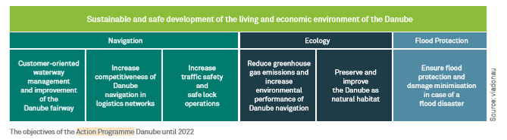
Transport Policy - in Austria Promotion of Inland Navigation
The ‘Overall Transport Plan for Austria’ sets out the objectives and policies of Austrian transport planning until 2025 for all transport modes
Action Programme Danube until 2022
Detailed basis for Austrian navigation policy is defined until 2022 in the Action Programme Danube (ADP)
Objectives apply equally to ecology and flood protection in addition to navigation
Reflects multifunctional character of the Danube
uses synergies between these three fields of action
Implemented by viadonau – Österreichische Wasserstraßen-Gesellschaft mbH (together with the BMK)
source: viadonau
Notes:
The ‘Overall Transport Plan for Austria’ sets out the objectives and policies of Austrian transport planning until 2025 for all transport modes.
The detailed basis for the Austrian navigation policy is defined until 2022 in the Action Programme Danube (APD), whose objectives, for the first time, apply equally to ecology and flood protection in addition to navigation itself. By proceeding in this way, the programme reflects the multifunctional character of the Danube and uses synergies between these three fields of action. The programme is being implemented by viadonau – Österreichische Wasserstraßen-Gesellschaft mbH, together with the Federal Ministry for climate, action, environment, energy, mobility, innovation and technology (BMK) , as well as in close cooperation with the relevant stakeholders.
The action programme’s six impact objectives (as shown in the diagram above) will be implemented in 23 measures, each of which contributes to one, two or all three fields of action. Underlying the efforts is the intention to continue strengthening inland navigation within the overall system of Austrian transport – also based on the European guidelines. The measures included in the action field of inland navigation refer to the areas of waterway infrastructure, lock operations, provision of user information (River Information Services), transport development, fleet modernisation and knowledge management.
Source: viadonau, Manual on Danube Navigation page 31.

Slide 22
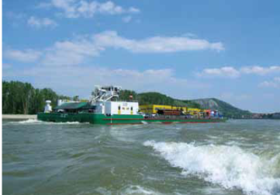
Promotion of Combined Transport Promotion of Inland Navigation
source: via donau
EU-Directive to increase the attractiveness of combined transport by
liberalising pre- and end-haulage
simplifying cross-boarder transport
promotion in Austria:
tax benefits
financial subsidies
exceptions to the ban on night-time driving
exceptions to the driving ban to relieve summer traffic
compensation of payloads
rest periods on rolling and floating roads
Notes:
An important step in enhancing the use of combined transport has been achieved through the adoption of a Directive on the establishment of common rules for certain types of combined transport of goods between Member States by the European Union (Directive 92/106/EEC). This directive aims to increase the attractiveness of combined transport by liberalising pre- and end haulage. Consequently, the main focus is set on simplifying cross-border transport. In addition, tax benefits for combined transport are included.
Promotion of combined transport in Austria
Financial subsidies: Special funding programmes are made available under certain circumstances by the Federal Ministry for climate, action, environment, energy, mobility, innovation and technology (BMK) to provide financial support for the investment and operating costs of combined transports (e.g. terminal support or the innovation programme Combined Cargo Transport).
Vehicle tax concessions: Vehicles registered in Austria that engage exclusively in in pre- and end-haulage transport to the closest technically suitable combined transport terminal are exempted entirely from vehicle tax (Motor Vehicles Tax Act, Federal Law Gazette 449/1992).
Exemption from the ban on night-time driving: Trucks with a maximum permissible weight of more than 7.5 tons are not permitted to drive between 10:00 pm and 5:00 am; excepted from this provision are tours undertaken in combined transport along precisely defined stretched between border crossings (Road Traffic Code, Federal Law Gazette 159/1960 and Ordinance, Federal Law Gazette 1027/1994).
Exemption from the ban on weekend and public holiday driving: As a rule, trucks with a maximum permissible weight of more than 3.5 tons are not permitted to drive between 3:00 pm and 12:00 am on Saturdays or between 12:00 am and 10:00 pm on Sundays and public holidays; excepted from this provision are tours undertaken in combined transport within the vicinity of defined railway stations and ports (Road Traffic Code, Federal Law Gazette 159/1960 and Ordinance, Federal Law Gazette 855/1994).
Exemption from the ban on driving to facilitate holiday traffic: Trucks or articulated vehicles with a maximum permissible weight of more than 7.5 tons are not permitted to drive between 8:00 am, i.e. 10:00 am and 3:00 pm on all Saturdays in the holiday months of July and August; excepted from this provision are tours undertaken in combined transport from or to the closest combined transport terminal (Travel Ban Calendar, Federal Law Gazette II 110/2017).
Compensation of payloads: An increase in the total weight of a vehicle from 40 to 44 tons is possible in pre- and end-haulage runs within combined transport (Motor Vehicles Act, Federal Law Gazette 267/1967).
Liberalisations: Cross-border pre- and end-haulage is liberalised for vehicles registered in EEA states and possessing a community license (Ordinance, Federal Law Gazette II 399/1997). In addition, bilateral authorisation is not required for pre- and end-haulage on road corridors leading to and from the six major rolling road terminals in Austria.
Rest periods on rolling and floating roads: According to EU regulations (Regulation (EC) No 561/2006 and the Working Hours Act, Federal Law Gazette 461/1969), the time that truck drivers spend on rolling or floating roads counts toward the mandatory rest periods.
Source: viadonau, Manual on Danube Navigation page 199 – 201.

Slide 23
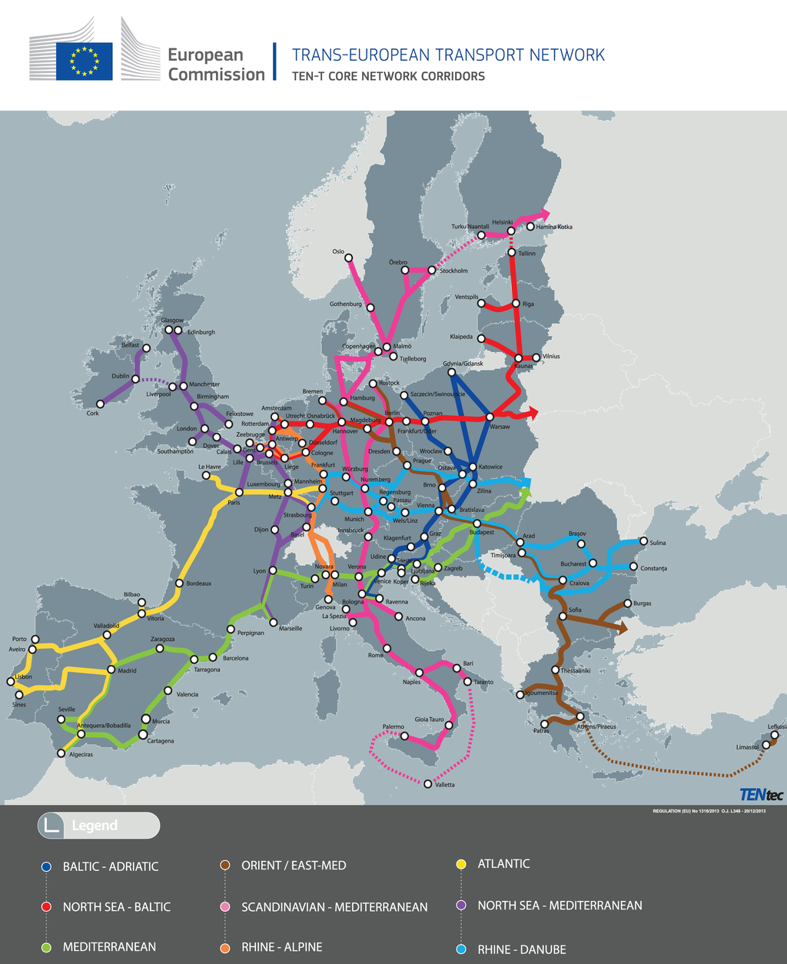
Quiz Promotion of Inland Navigation
Quelle: http://www.verkehr.sachsen.de/955.html
By when should a fully operational EU-wide trans-European core network be established?
2020 c) 2030
2025 d) 2040
Notes:
By when should a fully operational EU-wide trans-European core network be established?
2030

Slide 24
Legal Aspects
Inland Waterways
Freight Transport by Inland Vessels
Inland Vessels – Crew, Equipment, Drive
Promotion of Inland Navigation

Slide 25
Transportation Options Freight Transport by Inland Vessels
cargo space in its entirety (full load)
part of the available cargo hold (part load ), package good load
contract trip:
several trips on the basis of one contract agreement
often one year contracts
spot market:
day´s trading, for individual trips or cargoes in compliance with current prices
multimodal liner shipping:
specific loading and cleaning ports as well as arrival and departure times that are notified on a regular basis
Notes:
Transport companies offer cargo space either in its entirety (full load) or as part of the available cargo hold (part load). However, the freight contract concluded with the client can also apply to the transport of individual ‘packages’. This is known as general cargo transport. The transport of heavy and oversized goods (project cargo) differs from traditional shipping of general cargo primarily due to the need for special vessel and transhipment equipment and long-term transport planning.
Conventional bulk cargo transport on the Danube usually takes the form of contract trips, meaning several trips on the basis of a contract for a specific period of time. Contract trips are often agreed for a longer period in the form of an annual contract. This type of transport has the following characteristics:
• An agreed annual total quantity, whereby the time of the transport operations involved as well as the size of the part deliveries is not specified (this allows for the prevention of goods being transported during low-water periods) • Transport of full loads by motor cargo vessels or pushed convoys • More generous timeframes regarding arrivals and departures • Transport of the goods between one port of loading and one port of discharge • Involvement of just one consignor and one consignee
In addition to contract trips, ship transports are also carried out on the spot market, which means on the basis of a freight contract that is concluded for individual trips or ship loads according to the current market prices. Spot transport has the following characteristics:
• Conclusion of a freight contract (contract of carriage) applicable to a full, part or package good load • Specification of fixed delivery times (in part involving contractually agreed payment of penalties) • Fiercer competition before conclusion of the contract, because several quotes from different transport companies are generally obtained at short notice • Regular involvement of several actors (for instance forwarders, agencies)
Decreasing shipment sizes and an increasing number of suppliers and customers means that a high degree of punctuality and reliability with regard to departure and arrival times is expected. Multimodal liner services offer a solution in this case. Like passenger ships or regular-service buses, the cargo vessels of a liner service travel according to a fixed timetable to specific ports in which the cargo is generally transhipped for further transport by truck or rail. The flexibility in the formation of pushed convoys enables the simultaneous transport of different types of goods (for instance rolling goods, containers or bulk cargo) and helps to counterbalance disparity of traffic, i.e. different transport volumes on the route travelled.
Source: viadonau, Manual on Danube Navigation page 166-167.

Slide 26
Freight Contract Freight Transport by Inland Vessels
freight carrier: commercially accepts the transport of goods at its own responsibility using its own or other ships (e.g. shipping companies or forwarders)
contract between the consignor and the freight carrier determining the rights and obligations of the parties concerning the transport (e.g. amount of goods, delivery periods, costs,…)
Consignment note serves as documentation for the transport operation
Bill of lading often regulates the legal relationship between freight carrier and the consignee
cross-border transport: CMNI = international regulation for freight contracts
Notes:
A freight carrier commercially accepts the transport of goods at its own responsibility using its own or other ships (e.g. shipping companies or forwarders)
Transport operations are carried out on the basis of a freight contract (or contract of carriage) which is concluded between the consignor and the freight carrier either directly or indirectly. In the case of direct conclusion, the contract is concluded directly between the cargo owner and the shipping company. In contrast, there is at least one other party involved who acts as an intermediary if a contract is concluded indirectly (e.g. a forwarder or freighting company). The freight contract is concluded consensually between the parties. There is no special form required (freedom from any formal requirements).
A consignment note that serves as documentation for the transport operation is drawn up for each individual freight order. A bill of lading often regulates the legal relationship between the freight carrier and the consignee in inland navigation. The bill of lading provides the consignee with evidence of the right to receive the consignment and obliges the freight carrier to hand over the goods only on submission of the bill of lading. This transport document is customary in inland navigation and constitutes a document of title, the submission of which leads to a transfer of ownership of the goods. In other words, the bill of lading functions as a certificate of receipt for the goods, as a carriage promise for the transport of the goods and a promise to hand over the goods to the legitimate owner of the bill.
The Budapest Convention on the Contract for the Carriage of Goods by Inland Waterway (CMNI) is an international convention that harmonised the legal provisions governing contracts for the cross-border transport of cargo on inland waterways.
Source, viadonau, Manual on Danube navigation page 157,172-173, 219.

Slide 27
Bratislava Agreements Freight Transport by Inland Vessels
collection of private-law contracts to regulate cooperation among the shipping companies along the Danube
rights and obligations of shippers and shipping companies including:
the drawing up of the transport documents
accepting and handing over of cargo, loading- and unloading,
impediments to contract performance, liability etc.
agreements have increasingly receded into the background giving way to the CMNI
Notes:
The Bratislava Agreements are a collection of contracts under private law whose purpose is to regulate the cooperation among shipping companies operating on the Danube. Among these, the Agreement on General Conditions for the International Carriage of Goods on the River Danube is of particular importance. This regulates the rights and obligations of shippers and shipping companies in connection with the carriage of goods. Although the formally prescribed customer order sheet for transport is still provided for in the agreement, it no longer has any bearing on day-to-day practice. The most important provisions of the agreement pertain to the drawing up of transport documents, the accepting and handing over of the cargo to be transported, loading and unloading of vessels, calculating freight charges, liability, impediments to contract performance, the exercise of rights of lien and dealing with complaints. In recent years the regulations of the Bratislava Agreements have increasingly receded into the background and have given way to the CMNI.
Source: viadonau, Manual on Danube Navigation page 173.

Slide 28
Budapest Convention – CMNI Freight Transport by Inland Vessels
standardised rules for international carriage of goods (since April 2005)
applies to all contracts of carriage for transporting cargo by inland waterway where the port of loading or the port of discharge is located in a state that is party to the convention
contains general rights and duties of contracting parties :
type and content of transport documents
liability at loss or damage
exemption from liability
not ratified by Austria
Notes:
The Budapest Convention on the Contract for the Carriage of Goods by Inland Waterway (CMNI) is an international convention that harmonised the legal provisions governing contracts for the cross-border transport of cargo on inland waterways for the very first time. The convention was concluded on 22 June 2001 under the patronage of the Central Commission for the Navigation of the Rhine, the Danube Commission and the United Nations Economic Commission for Europe and came into force on 1 April 2005 ( Central Commission for the Navigation of the Rhine et al., 2000). The convention applies to all contracts of carriage for transporting cargo by inland waterway where the port of loading or the port of discharge is located in a state that is party to the convention. It regulates the general rights and obligations of the contractual parties, primarily those of the freight carrier, the consignor and the consignee. In general, the convention includes regulations pertaining to
• type and content of the transport documents, • liability in the event of loss or damage to cargo during transport and • circumstances and situations that allow exemption from liability.
All Rhine and Danube riparian states have ratified the Budapest Convention, with the exception of Austria. Therefore, from a purely legal perspective, the provisions of this convention are applied to all cross-border transfers, as either the port of loading or discharge is located within the CMNI territory and the regulations are hence valid.
Source: viadonau, Manual on Danube Navigation page 172-173.

Slide 29
Liability – CMNI Freight Transport by Inland Vessels
obligations of the shipper: Art 6:
payment obligation
information on the goods in writing form
packaging of goods in an appropriate way
obligations of the carrier:
Art 3 (1): „The carrier shall carry the goods to the place of delivery within the specified time and deliver them to the consignee in the condition in which they were handed over to him.”
Art 11: carrier shall issue a transport document
Art 16: liability for loss resulting from loss or damage to the goods
Art 17: liability for servants and agents
Art 18: special exonerations from liability
Art 19: calculation of compensation
Art 20: maximum limits of liability
Notes:
The entire CMNI can be found here: http://www.unece.org/fileadmin/DAM/trans/main/sc3/cmniconf/cmni.english.pdf

Slide 30
Liability - in Austria, Transport Insurance Freight Transport by Inland Vessels
Liability in Austria
CMNI not ratified
Liability regulated by federal law
Transport insurance:
Distinction between goods transport insurance and transport liability insurance
Goods transport insurance: core objective = interest in material compensation - should cover the interest in the goods measurable in money; aims at the risk of transport and storage
Transport liability insurance or carrier's liability insurance: core objective = exemption from liability risk - pure liability insurance; target group: forwarders, carriers and warehouse keepers to insure their liability risk for damage to goods during their period of custody In addition to classic damage to goods, damage caused by delay and damage due to gross negligence are usually also included in the scope of cover.
Demarcation difficult in practice
Notes:
All Rhine and Danube countries except Austria have ratified the Budapest Convention. From a purely legal point of view, therefore, the provisions of this Convention are only not applied to transports within Austria. In all other cases, either the port of loading or the port of discharge is located in the CMNI area, which means that the regulations are valid here.
Source: viadonau, Manual on Danube Navigation, page 172-173.
Goods transport insurance is intended to cover the interest in the goods measurable in money; it is therefore aimed at the risks of transport and storage (=interest in integrity). Naturally, this interest accrues to the party who would suffer the damage, i.e. usually the sender or the recipient, depending on the ownership of the goods at the time of transport. Specifically, the risks to the goods are insured during transport, so it is a pure goods (transport) insurance, which in a certain way includes an interest in preserving the goods. The freight forwarder and the carrier are not obliged to take out goods transport insurance without an order from the consignor, but they do have a duty to provide advice, as they are supposed to represent the interests of the consignor in the best possible way - especially if the consignor is obviously inexperienced.
In contrast to goods transport insurance, carrier liability insurance is a pure liability insurance. As already mentioned, it must be taken into account as a differentiating factor who has a special interest in the respective insurance. The target group for transport liability insurance (or otherwise called carrier liability insurance) are forwarders, carriers and warehouse keepers to insure their liability risk for damage to goods during their period of custody. In addition to classic damage to goods, the scope of cover usually also includes damage caused by delay and damage due to gross negligence. In contrast to goods transport insurance, which insures the owner (shipper or recipient) (=interest in integrity), transport liability insurance thus protects the forwarder, carrier or warehouse keeper against any claims for damages by the shipper/recipient in the event of damage occurring in connection with the transport, which are usually covered by the transport liability insurance through the insurer. In Austria there is no legal obligation to take out transport liability insurance.
Source: Thume, Versicherungen des Transports - Einführung, TranspR (2006), 1 (3-4).

Slide 31
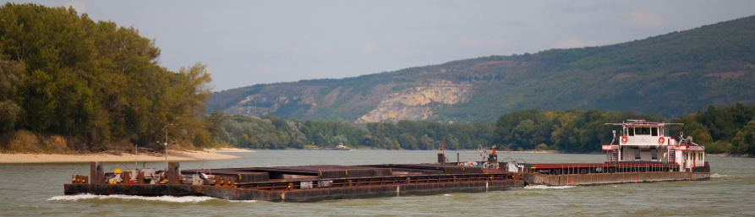
Quiz Freight Transport by Inland Vessels
What is a freight carrier?
e.g. shipping company or forwarder
person, who commercially accepts the transport of goods at its own responsibility using its own or other ships
Tour guide through a camp
Commission agent
Quelle: viadonau
Notes:
What is a freight carrier?
a) e.g. shipping company or forwarder
b) person, who commercially accepts the transport of goods at ist own responsibility using ist own or other ships

Slide 32
Legal Aspects
Inland Waterways
Freight Transport by Inland Vessel
Inland Vessels – Crew, Equipment, Drive
Promotion of Inland Navigation

Slide 33
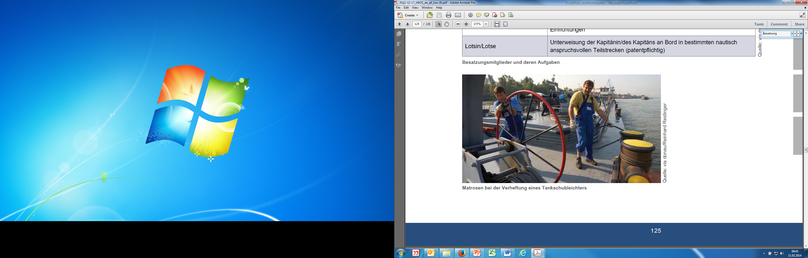
Crew Numbers and Travel Time Inland Vessels – Crew, Equipment, Drive
source : viadonau/ Reinhard Reidinger
minimum crew number depends on size, equipment and operating time
different crew members
with different competencies and tasks
e.g. captain, helmsman, deck crew, engine-minder,…
recommendations with respect to the crew of inland vessels can be found in Chapter 23 of Resolution No. 61 of the United Nations Economic Commission for Europe (UNECE)
in Austria regulated within the “Schiffsbesatzungsverordnung “ and the “Arbeitszeitengesetz” (AZG)
legally regulated resting periods!
Crewman connecting a tank lighter
Notes:
An inland vessel is operated by a crew comprising of different members with different competencies and tasks. The minimum crew for inland vessels and the composition of the crew depends on the size and equipment of the vessel and on its operating structure.
Recommendations with respect to the crew of inland vessels can be found in Chapter 23 of Resolution No. 61 of the United Nations Economic Commission for Europe (UNECE) concerning the technical requirements for inland vessels. The minimum crew number and composition as well as the competencies of crew members are regulated by national legislation along the Danube. On the Rhine, the relevant requirements are laid down by the Rhine Vessel Inspection Regulations.
The crew prescribed for the respective operating modes must be on board the vessel at all times while it is travelling, with due consideration of worktime and rest period regulations. Departure is not permitted without the prescribed number of minimum crew. The number of members of the minimum crew for motor cargo vessels, pushers and vessel convoys depends on the length of the vessel or convoy and the respective mode of operation.
The following distinctions are made for modes of operation:
• A1: Daytime navigation for maximum 14 hours within a period of 24 hours
• A2: Semi-continuous navigation for not more than 18 hours within a period of 24 hours
• B: Continuous navigation for 24 hours and more
Source: viadonau, Manual on Danube Navigation page 140-141.

Slide 34
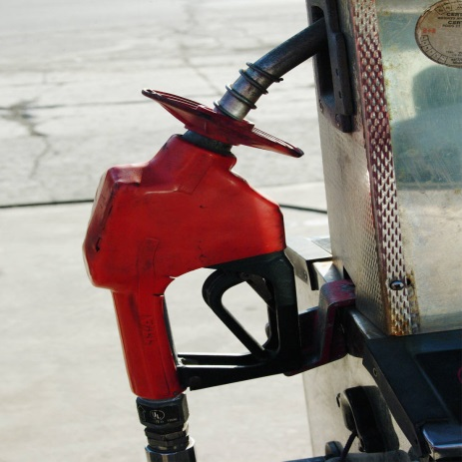
Fuel Inland Vessels – Crew, Equipment, Drive
Ships usually powered by diesel engines
Emission-optimized
specific fuel consumption 0.2 kg/kWh
in the future:
gas-powered engines
fuel cells
Directive 2009/30/EC Sulphur content of all fuels limited to 0.001%
the most effective techniques for reducing engine emissions and fuel consumption, among others:
liquefied natural gas (LNG) engines
Low sulphur fuel
Diesel oxidation catalyst
Notes:
In the medium term, diesel engines appear to remain the most common type of propulsion in inland navigation. In the long term, the use of gas-powered engines and fuel cells is conceivable. This offers great potential for a significant reduction in emissions from inland waterway vessels.
In January 2011 the EU Directive 2009/30/EC came into force, which limits the sulphur content in all fuels used in inland navigation to 0.001% (10 ppm), thus leading to a reduction of SOx emissions by almost 100%.
Legislation regarding emissions is becoming increasingly stringent and environmental friendliness is becoming an increasingly important competitive advantage. It is therefore necessary to optimise engines in terms of fuel consumption and emission performance. The diesel engines currently used in inland navigation are emission-optimised and their specific fuel consumption is 0.2 kg/kWh. This value has remained unchanged for several years, as nitrogen oxide emissions had to be reduced at the expense of fuel consumption. When a ship's engine is replaced, its average age is about 15 years or even more. It will therefore take much longer for inland waterway transport to meet new emission standards than for trucks, whose engines have an average service life of five years.
International research projects and trials have shown that the most effective techniques for reducing engine emissions and fuel consumption are as follows:
Engines for liquefied natural gas (LNG)
Low sulphur fuel
Diesel oxidation catalyst (requires low sulphur fuel)
Selective catalytic reduction
Fine dust filter
Advising Tempomaat
Source: viadonau, Manual on Danube Navigation page 132-133.

Slide 35
Fuel/exhaust emissions equipment, propulsion
Regulation (EU) 2016/1628 (Non-Road Mobile Machinery/NRMM Regulation):
regulates exhaust emission limits for new engines
limit values are very strict -> Emission reduction technologies and particle filters are necessary
for the first time, a limit value for the number of particles must also be complied with (engines with a power output P ≥ 300 kW).
EU Commission also discusses voluntary environmental standards that could also be applied to existing ships
currently, such environmental standards exist in Belgium and the Netherlands
compliance marked by Green Award. Ships with this award can receive up to 30% reduced port fees
Notes:
Regulation (EU) 2016/1628 (also known as the Non-Road Mobile Machinery/NRMM Regulation) regulates the limits for exhaust emissions from new engines. The limit values to be met are very strict, which is probably why emission reduction technologies such as exhaust gas aftertreatment by selective catalytic reduction (SCR) and particle filters must be used. For the first time, a limit value for the number of particulates must also be complied with (engines with a power output P ≥ 300 kW).
In the meantime, the EU Commission is also discussing voluntary environmental standards which could also be applied to existing ships. Currently, there are such standards in Belgium and the Netherlands, compliance with which is marked by the so-called Green Award. Ships that have this award can receive reductions of up to 30 percent in port fees.
Source: viadonau, Manual on Danube Navigation, page 132-133.

Slide 36
Excursus: Transport of Hazardous Goods
potential risk of certain goods (for humans, animals, objects, or environment) e.g. petroleum substances and some fertilizers
internationally determined in the ADN (European Agreement concerning the international carriage of dangerous goods by inland waterways).
classification of the goods, including allocation criteria and review procedures
use of packaging, tanks and containers for bulk cargo
shipping procedures (e.g. marking and labelling)
regulations concerning the loading, transport, unloading and other handling of goods
regulations concerning a ship’s crew, equipment, operation and documentation
regulations for shipbuilding
Notes:
The transport of hazardous goods by inland vessel is regulated by the European Agreement Concerning the International Carriage of Dangerous Goods by Inland Waterways (ADN). This agreement encompasses all hazardous goods and specifies whether or not these can be transported by inland vessel. There are special regulations for the approved hazardous goods concerning the following points:
• Classification of the goods, including allocation criteria and review procedures • Use of packaging, tanks and containers for bulk cargo • Shipping procedures (e.g. marking and labelling) • Regulations concerning the loading, transport, unloading and other handling of goods • Regulations concerning a ship’s crew, equipment, operation and documentation • Regulations for shipbuilding
Source: viadonau, Manual of Danube Navigation, p. 174.

Slide 37

Quiz Crew, Equipment, Drive
Which of the following goods is an hazardous good?
agricultural machinery c) biogenic raw materials
new cars d) petroleum products
Quelle: http://www.goldunze.de/rohstoffe/rohoel/rohoel/
Notes:
Which of the following goods is an hazardous good?
Petroleum products

Slide 38
Internet Research final exercise
Search on the Internet for transport policy initiatives!
Write down the most important basic information, such as:
Name of policy document
Policy type (law, programme, action plan, initiative, other)
Geographical coverage (regional/ national/ transnational/ European)
What is insufficient/Lacking in that policy document?
Who is the policy maker of this policy document?
Involved Target Group (public, private or both sectors)
What can be improved regarding „modal share promotion“?
Create a PowerPoint, a flipchart, a Prezi, etc.

Slide 39
Sources
BMK (2021): Mobilitätsmasterplan 2030 für Österreich. Zugang; https://www.bmk.gv.at/dam/jcr:6318aa6f-f02b-4eb0-9eb9-1ffabf369432/BMK_Mobilitaetsmasterplan2030_DE_UA.pdf
European Commission, Annex to the Communication on the European Green Deal Roadmap - Key actions, https://ec.europa.eu/info/sites/info/files/european-green-deal-communication-annex-roadmap_en.pdf.
European Commission, Communication and roadmap on the European Green Deal, https://eur-lex.europa.eu/legal-content/EN/TXT/?qid=1576150542719&uri=COM%3A2019%3A640%3AFIN.
Europäische Kommission, der europäische Grüne Deal, https://eur-lex.europa.eu/resource.html?uri=cellar:b828d165-1c22-11ea-8c1f-01aa75ed71a1.0021.02/DOC_1&format=PDF
Europäische Kommission, Ein europäischer Grüner Deal, https://ec.europa.eu/info/strategy/priorities-2019-2024/european-green-deal_de
European Commission, Annex to the Communication on the European Green Deal Roadmap - Key actions, https://ec.europa.eu/info/sites/info/files/european-green-deal-communication-annex-roadmap_en.pdf
European Commission, Sustainable and Smart Mobility Strategy – putting European transport on track for the future, https://eur-lex.europa.eu/resource.html?uri=cellar:5e601657-3b06-11eb-b27b-01aa75ed71a1.0001.02/DOC_1&format=PDF
Europäische Kommission (2019): Der europäische Green Deal, Brüssel Zugang: https://eur-lex.europa.eu/legal-content/DE/TXT/?uri=COM%3A2019%3A640%3AFIN
Europäische Kommission (2021): NAIADES III: Boosting future-proof European inland waterway transport Zugang: https://ec.europa.eu/transport/sites/default/files/com20210324-naiades.pdf
Thume, Versicherungen des Transports - Einführung, TranspR (2006), 1 (3-4).
viadonau (2019): Manual on Danube Navigation, Vienna.
Order or download: http://www.viadonau.org/en/newsroom/publications/manual-on-danube-navigation/

Slide 40


Further Information
We hope our set of slides has met your expectations!
- you are free to use, adapt and share this slides and to use it for your lectures.
For questions and feedback please do not hesitate to contact us:
rewway@fh-steyr.at
Further set of slides are available at:
http://www.rewway.at/en/teaching-materials/bundles/
Maybe you are interested to book a guest lecture or an excursion?
http://www.rewway.at/en/services/

